Slide 1
Build a multi-dimensional Evidence Map with Views and Paragraphs
Sachit Thapa
Armen Danielyan

Slide 2




Who We Are
Armen Danielyan
Technical Lead
Digital Development @ FHI 360
adanielyan@fhi360.org
https://linkedin.com/in/adaniely
Sachit Thapa
Senior Web Developer
Digital Development @ FHI 360
sthapa@fhi360.org
https://linkedin.com/in/thapasachit

Slide 3

Our Journey
“You can always count on the Americans to do the right thing after they have tried everything else”
Winston Churchill

Slide 4
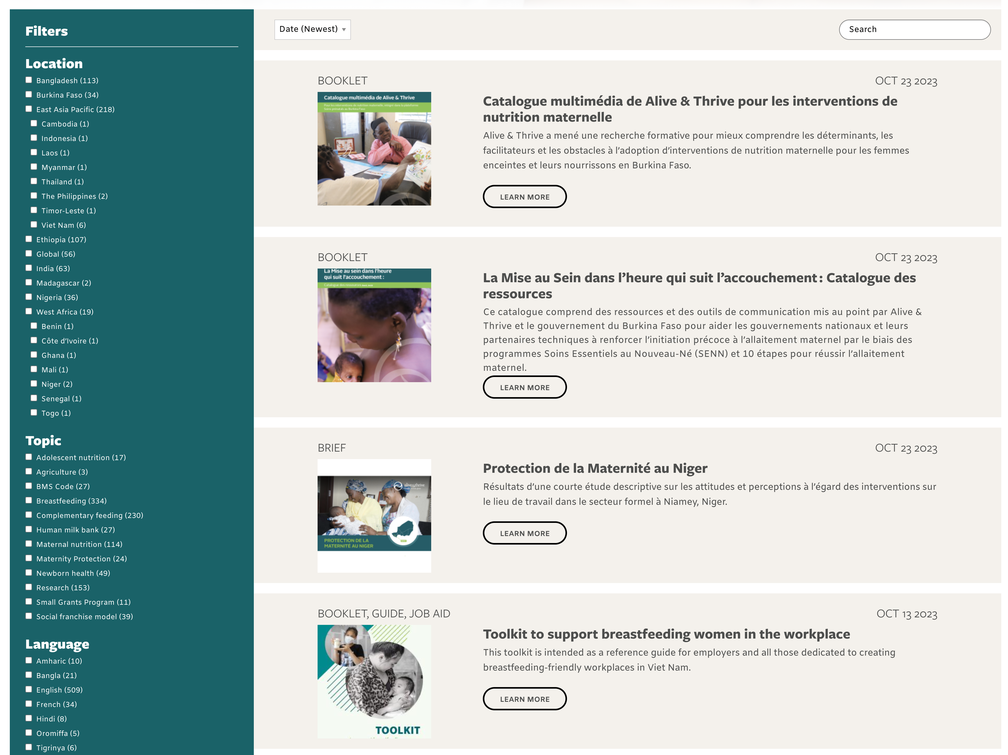
Resource Library

Slide 5
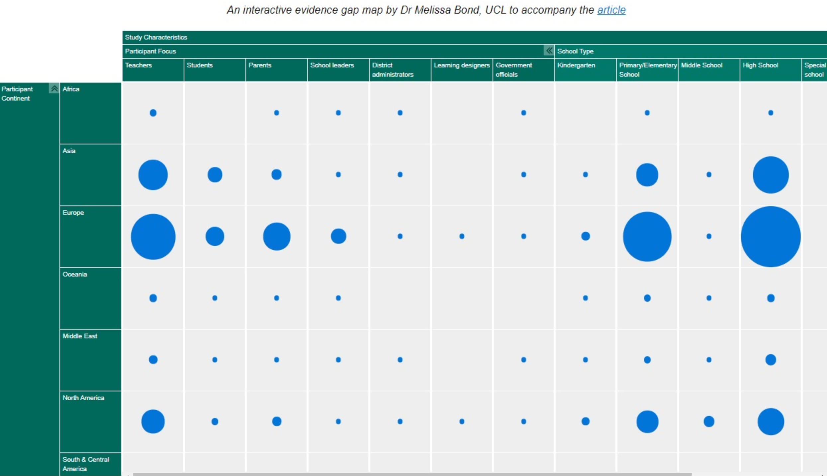
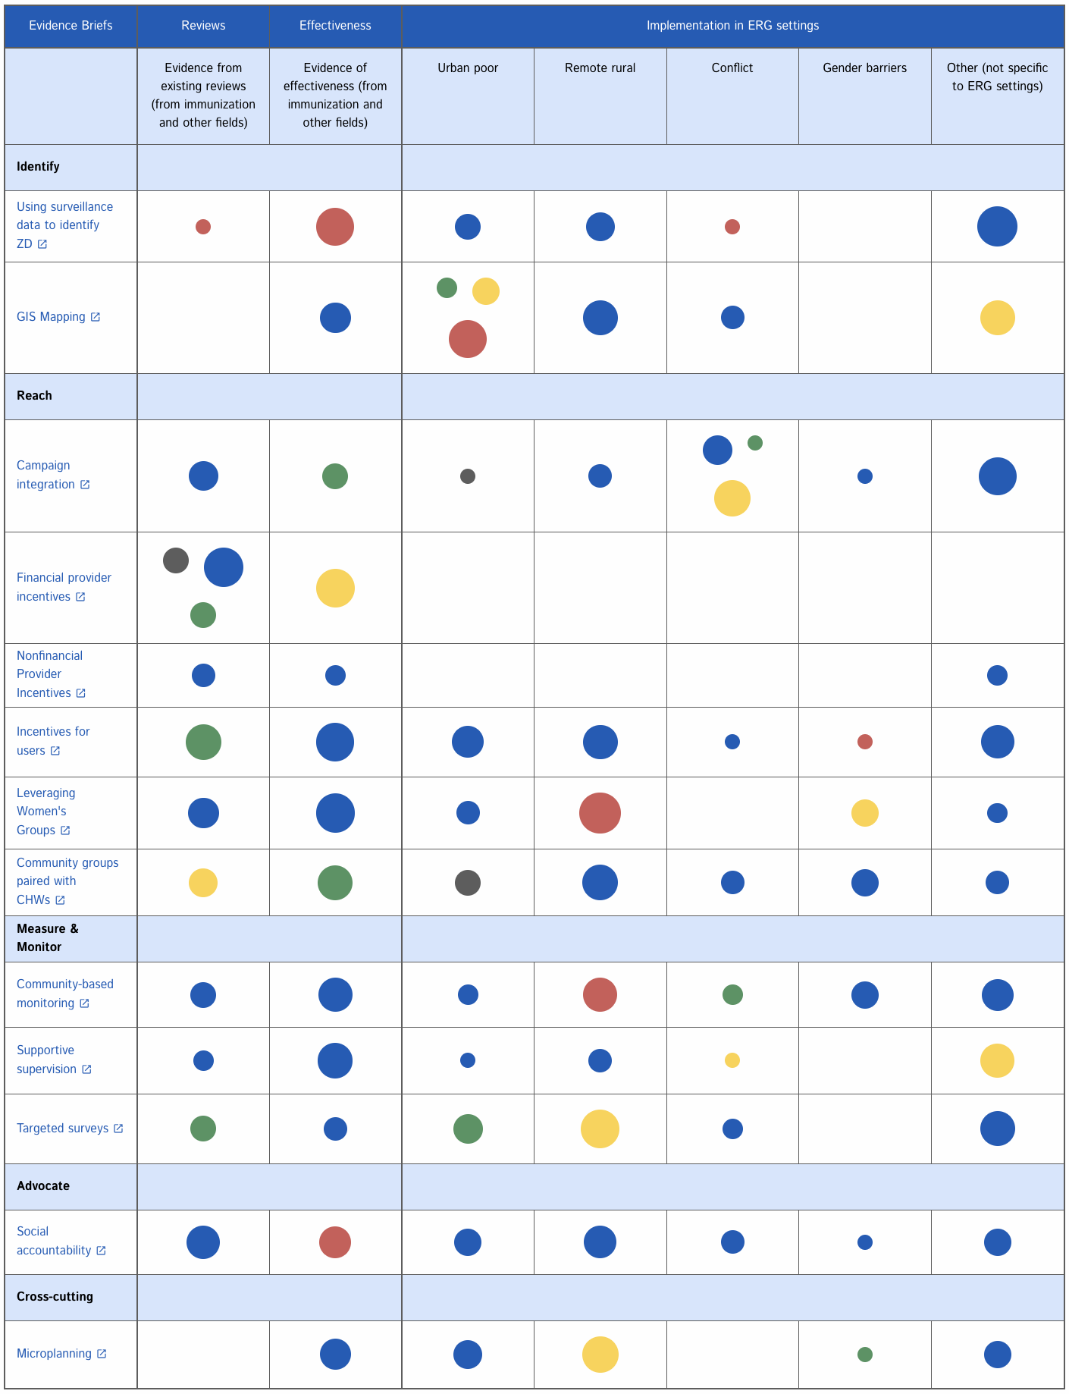
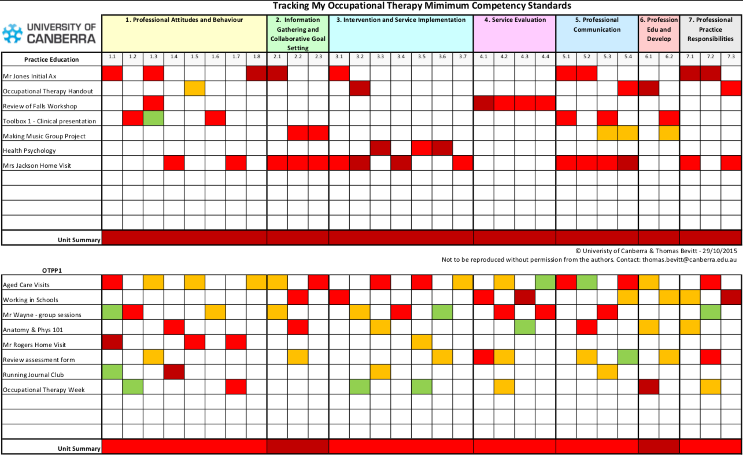
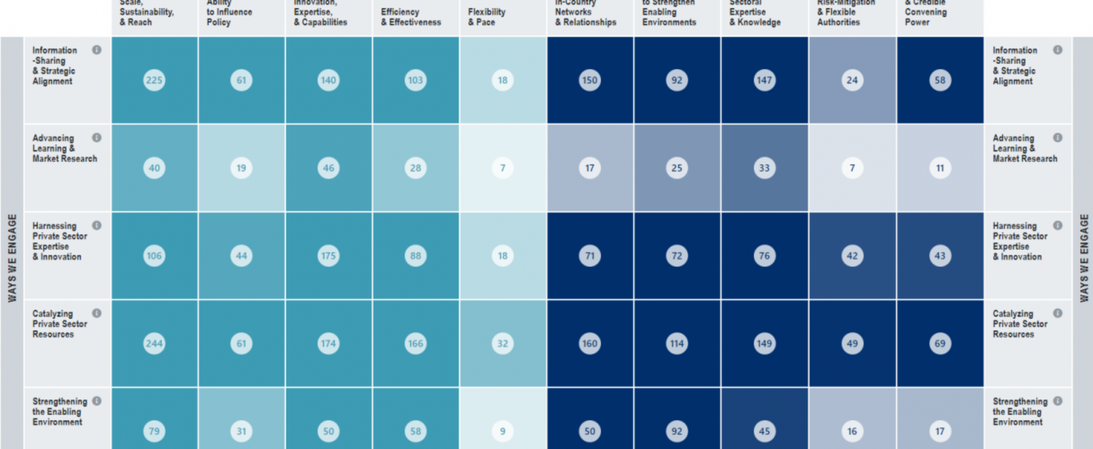
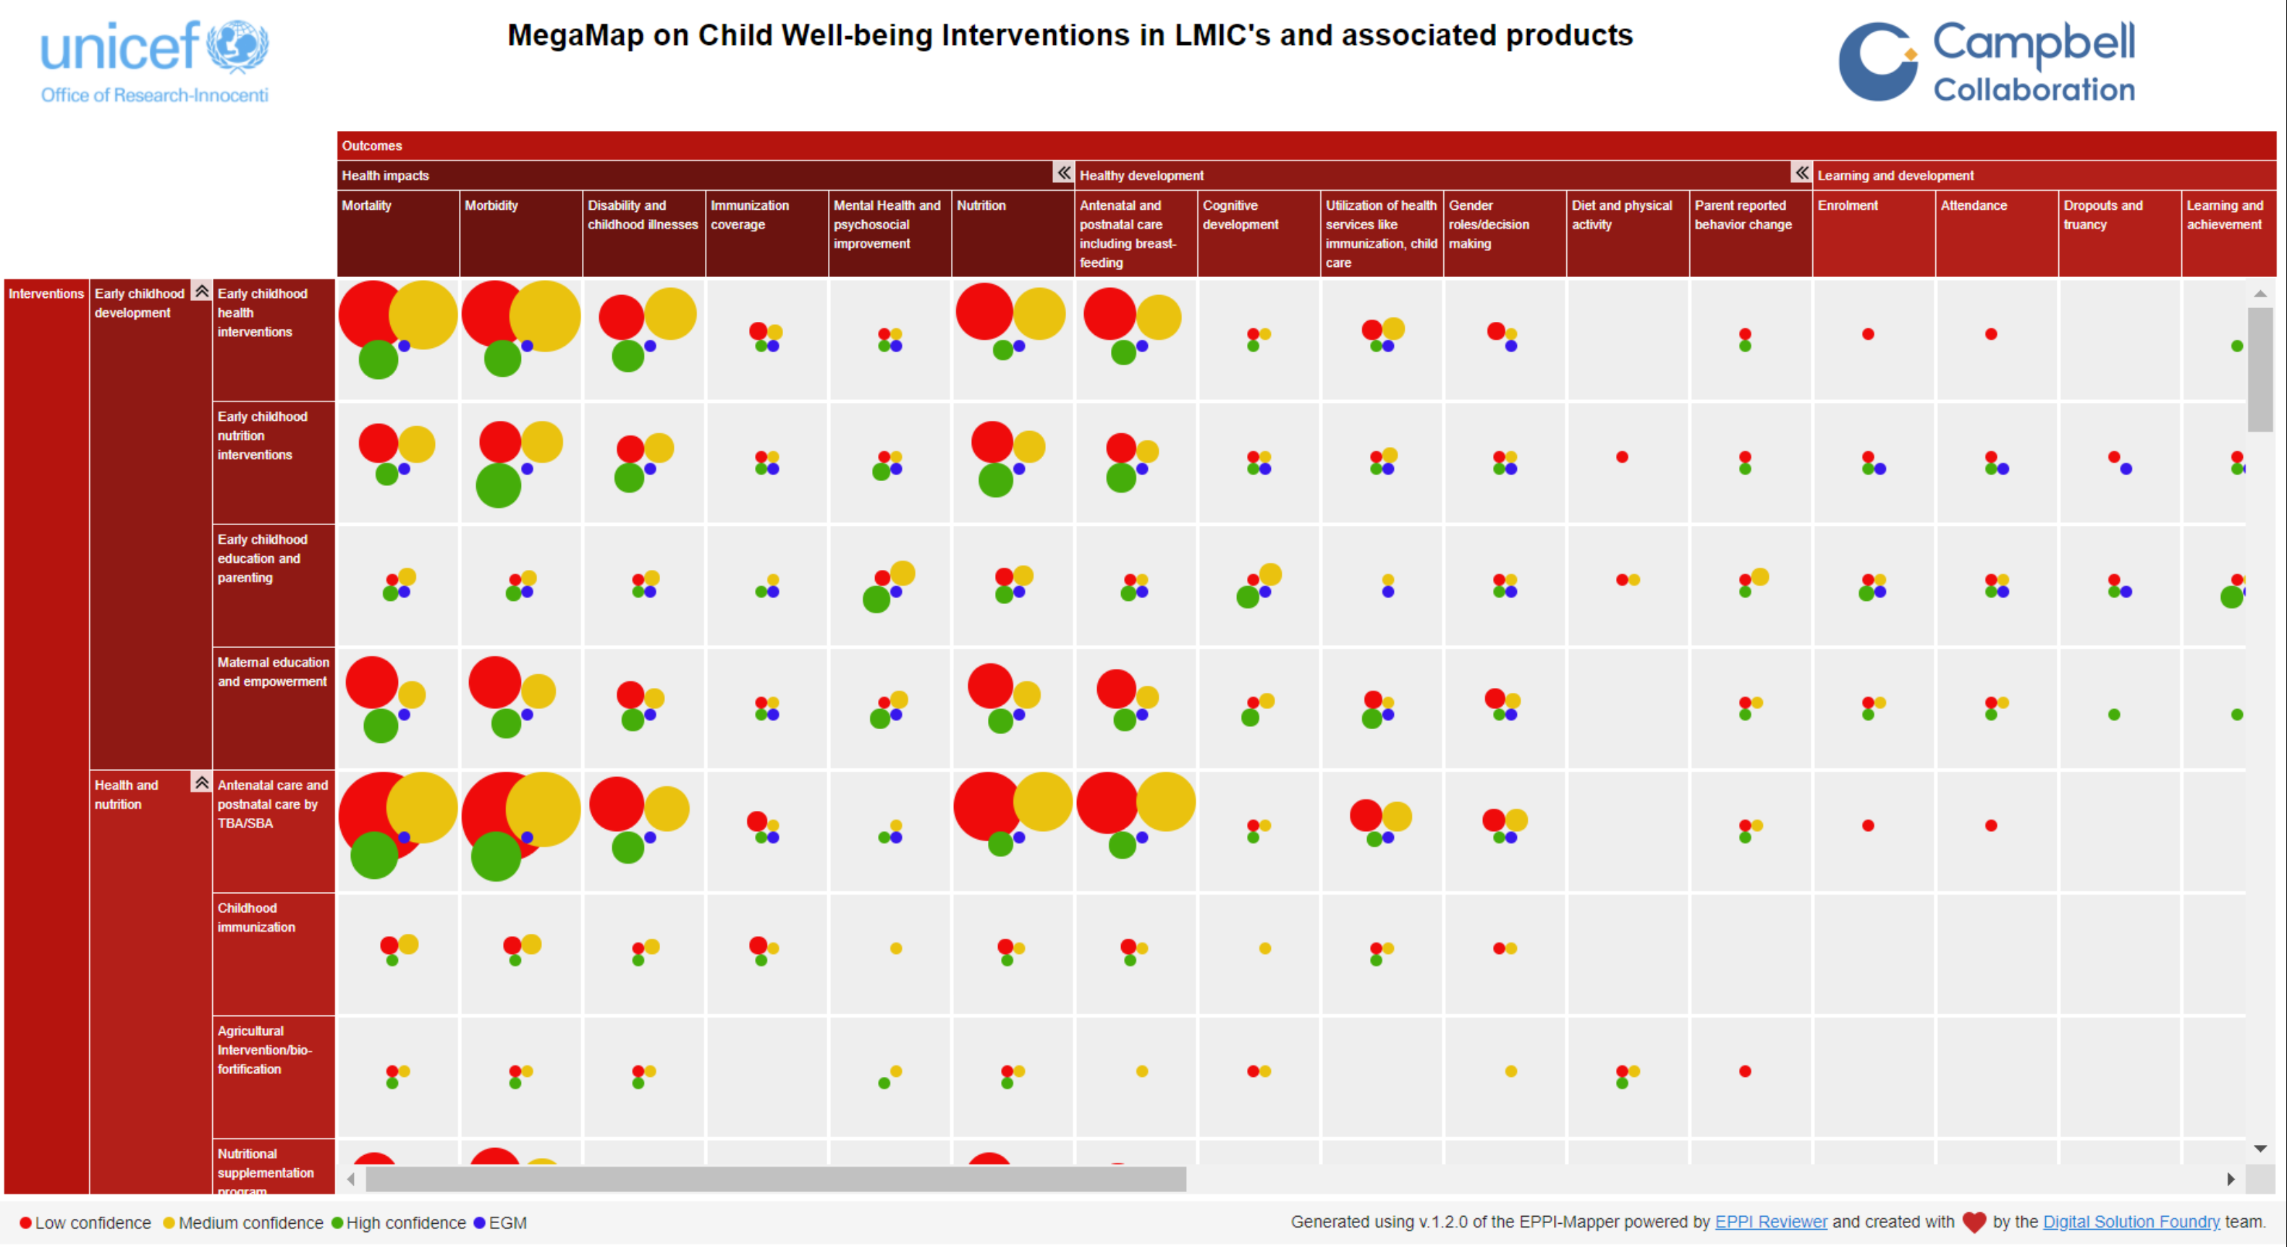
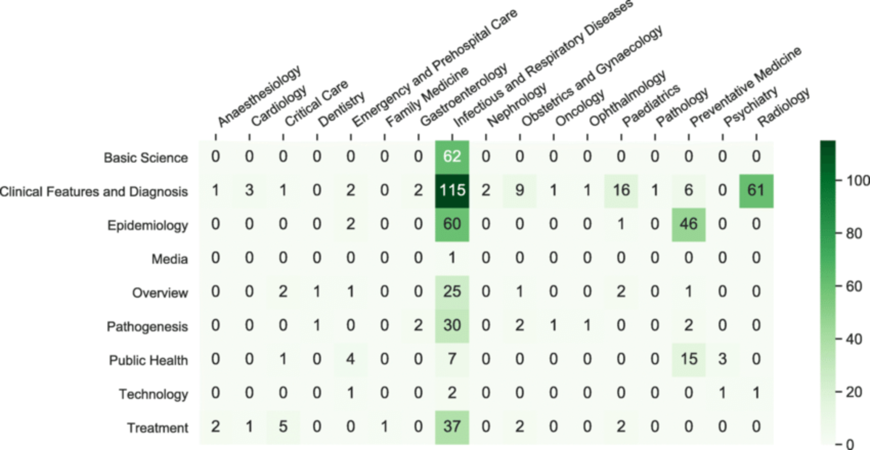
What is an Evidence Map
An evidence map is a visual representation that systematically organizes and displays available research evidence on a specific topic or question.

Slide 6
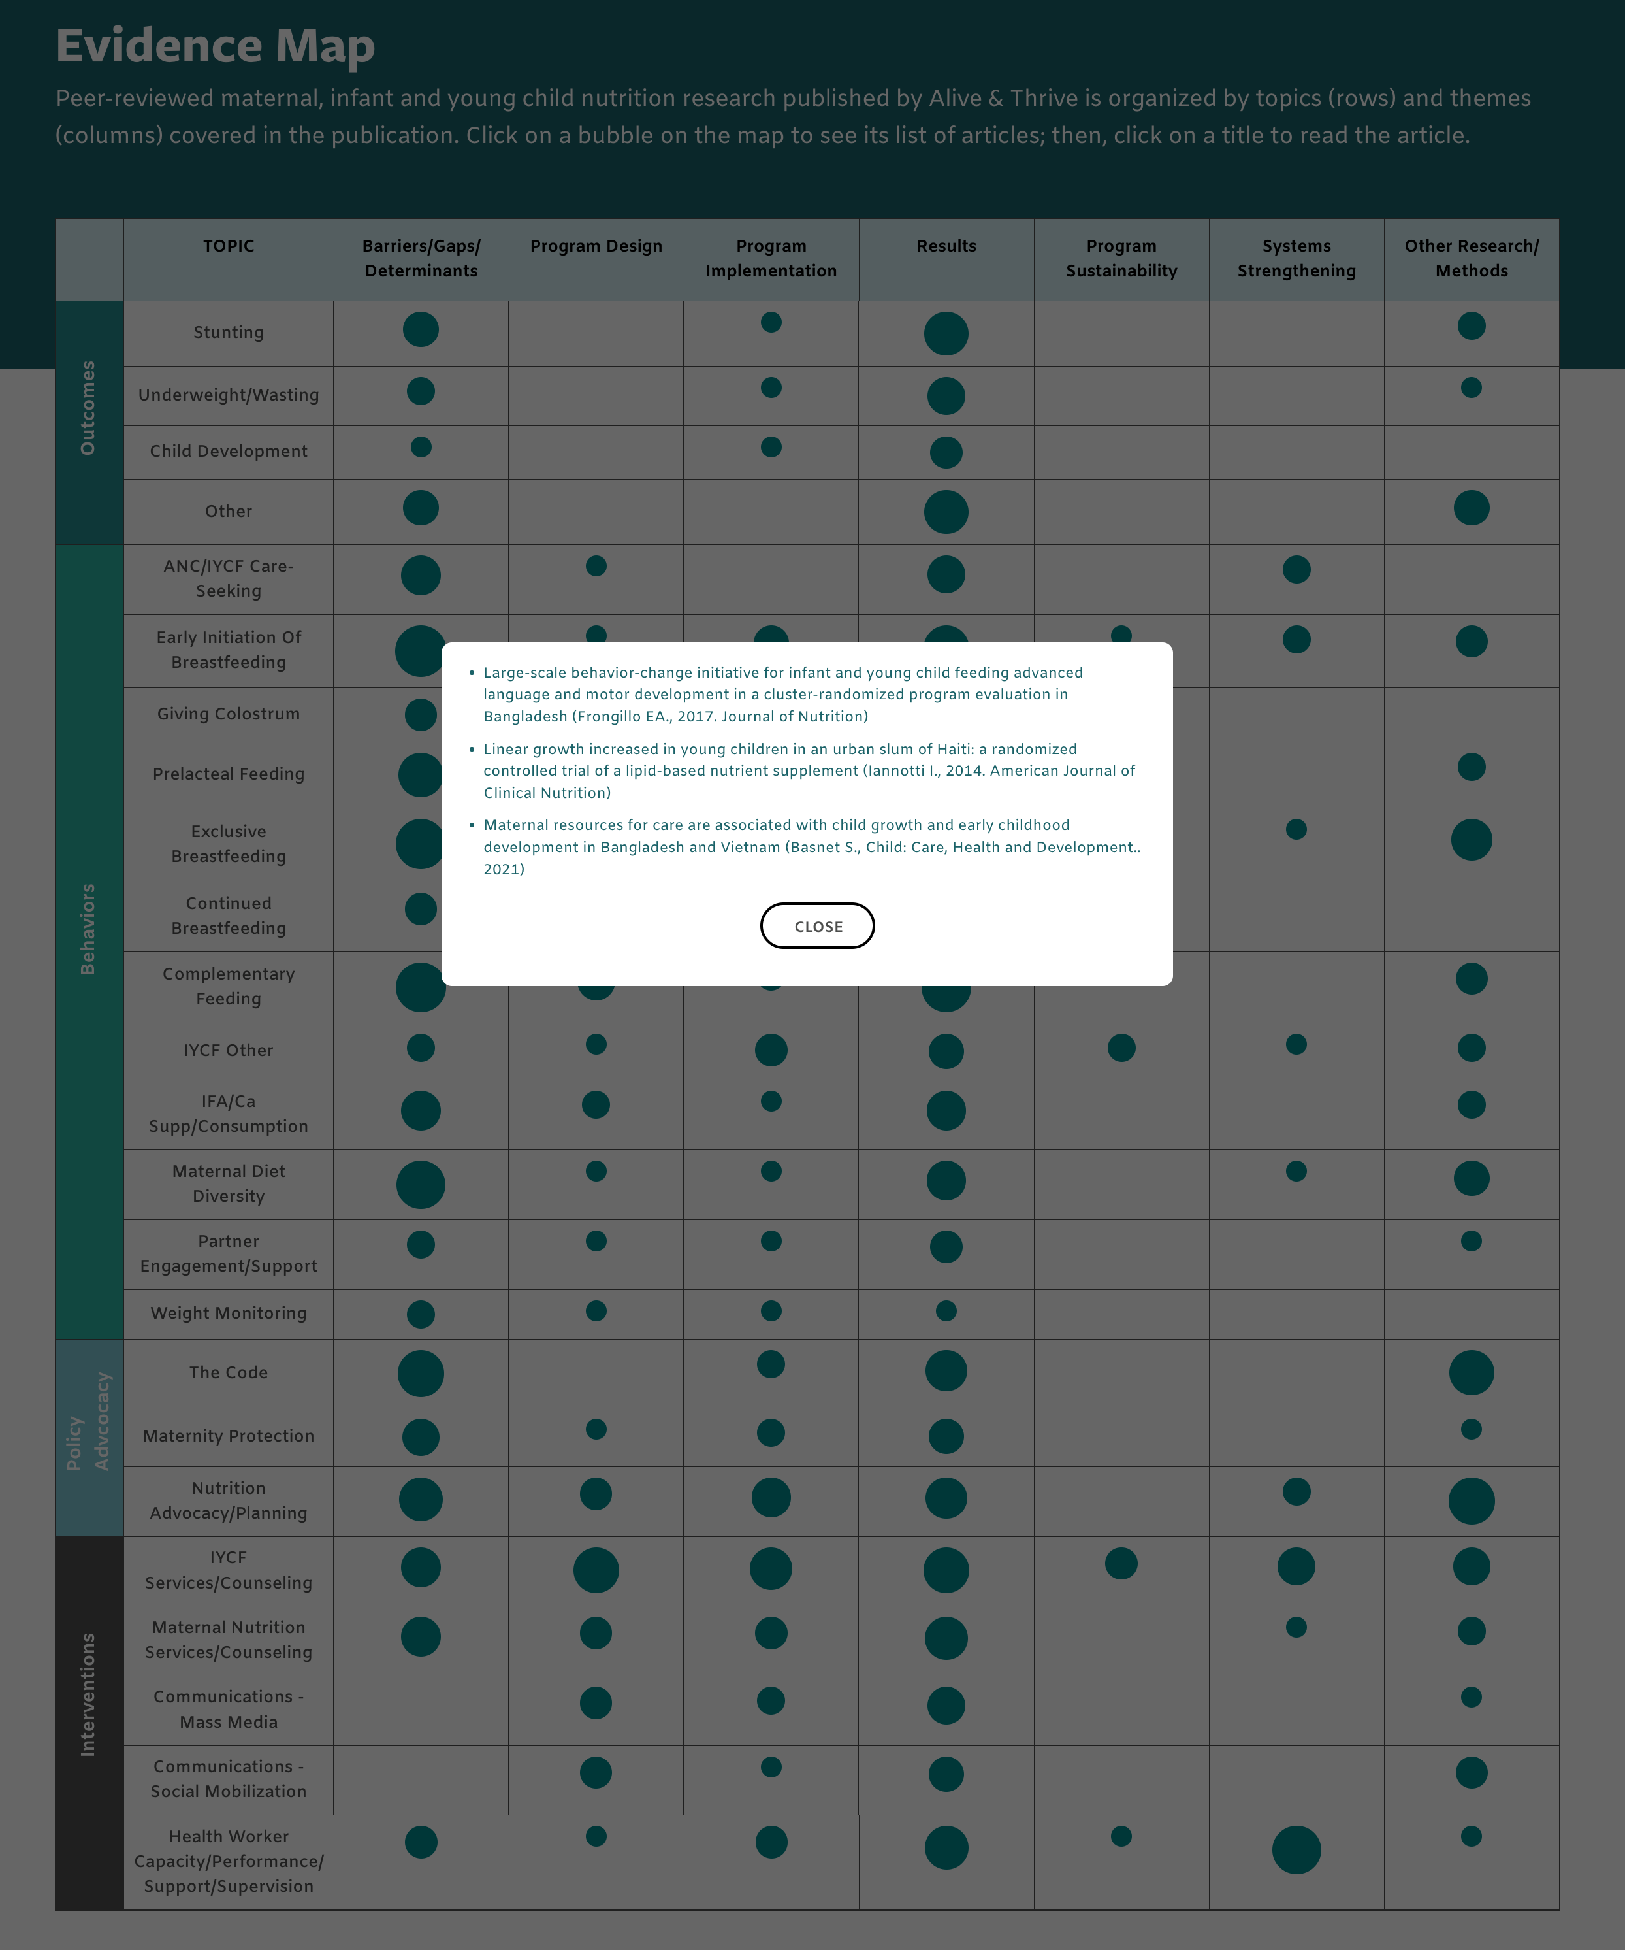
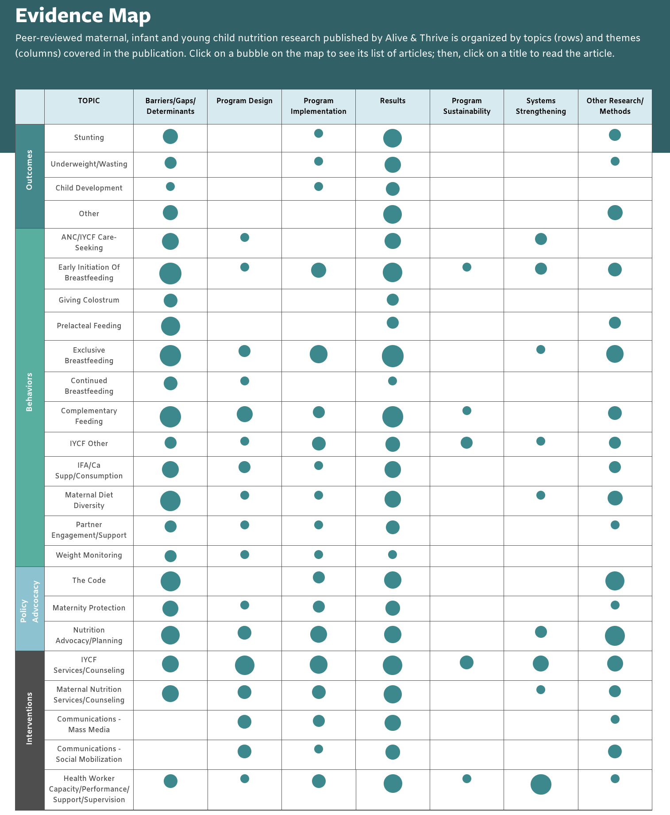
What Are We Building?

Slide 7

Initial Plan
Drupal
React App
JSON API

Slide 8
Evidence Map Structure
Column List
Row List
Cell List 1
Cell 1
Cell 2
...
...
Cell List N
Cell 1
Cell 2
Cell M
…
Cell M
…
…
…
…
Cell
List 1
Cell 1
…
Cell M
...
Cell 1
…
Cell M
Cell
List N
Cell 1
…
Cell M

Slide 9
Views Field View
Views Field View module allows you to embed one view into another view and
pass arguments along.
Rows List View
Row (Cells List)
View 1
Cell View1
…
Cell View M
...
Cell View 1
…
Cell View M
Row (Cells List)
View N
Cell View 1
…
Cell View M

Slide 10
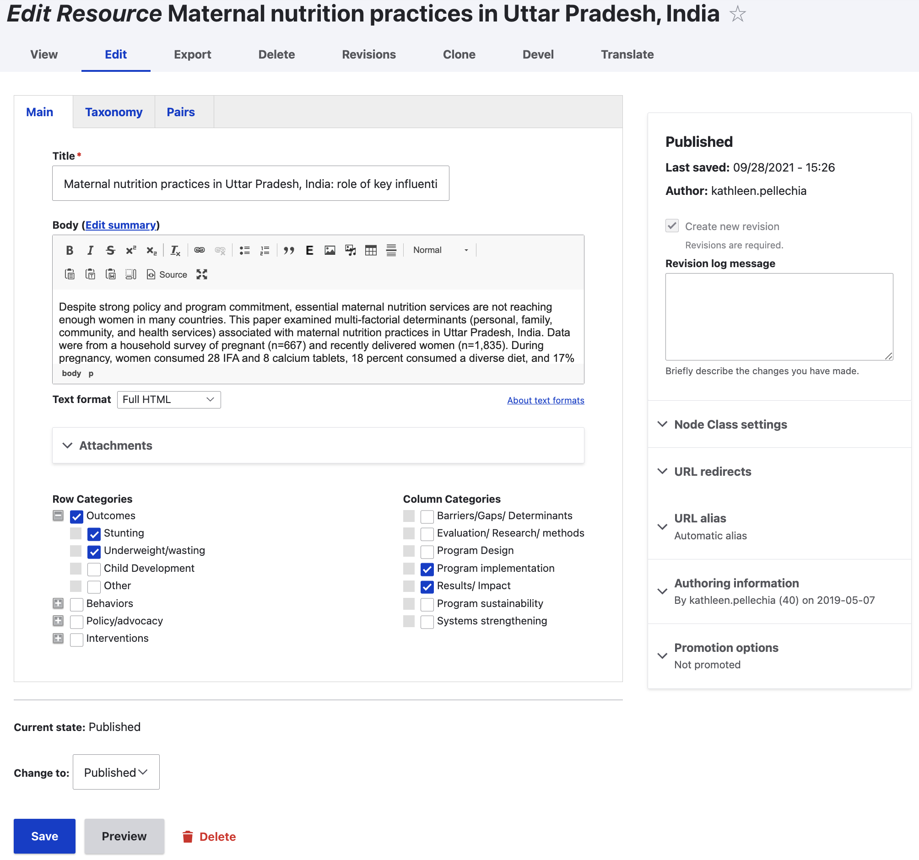
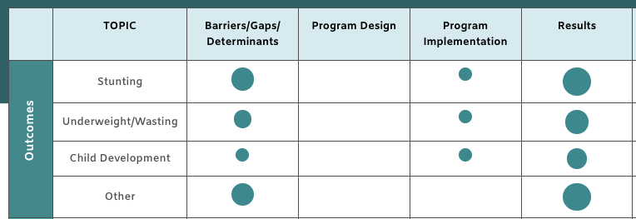

1st Attempt
Drupal
Views Field View
3 Nested Views (Rows List, Row, Cell)
Rows List View has one "Views" field per taxonomy term
Hardcoded values for contextual filters (tids)
2 Term Reference Fields
Unwanted combinations of category pairs.
Had to create node duplicates/aliases per wanted pair, with one category pair in each alias

Slide 11
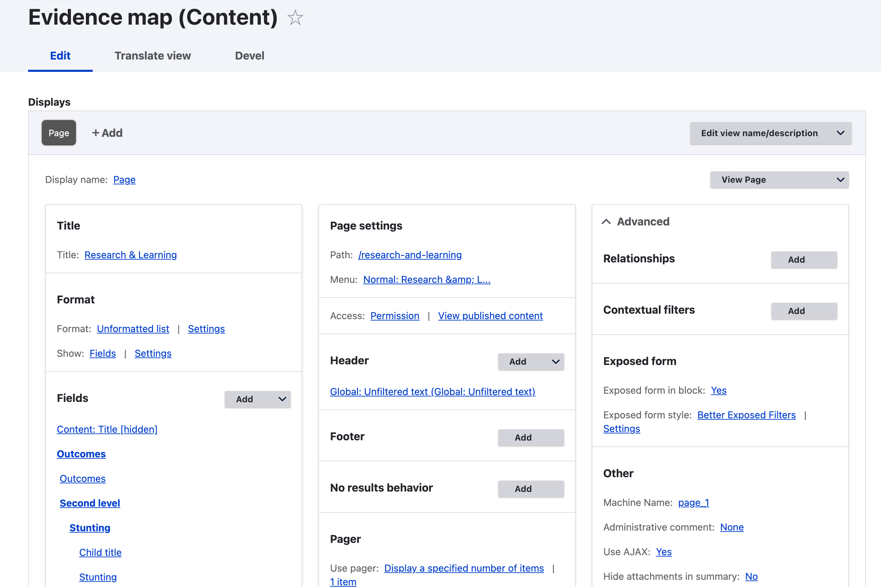
1st Attempt Details: Table View (Rows List)

Slide 12
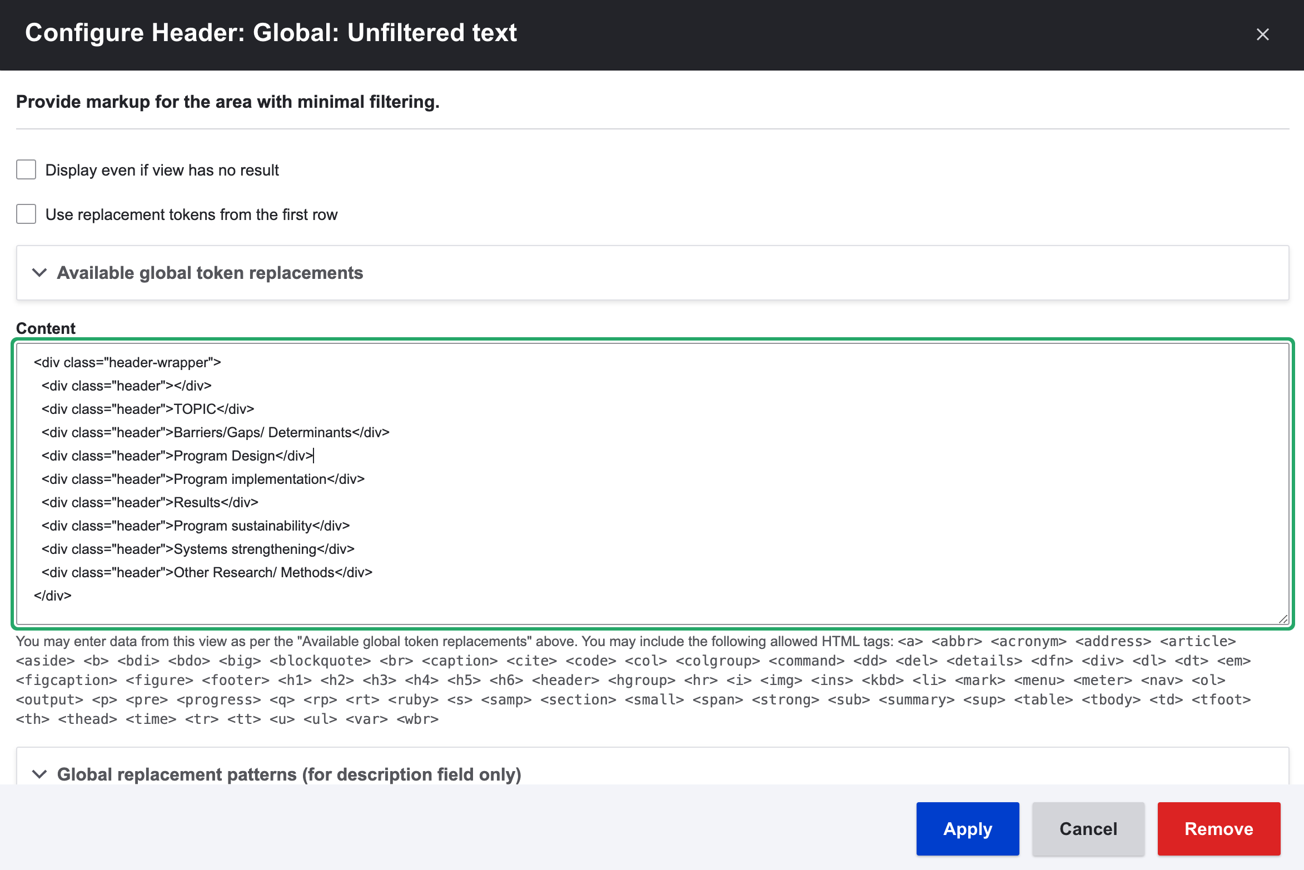
1st Attempt Details: Header of Table View

Slide 13
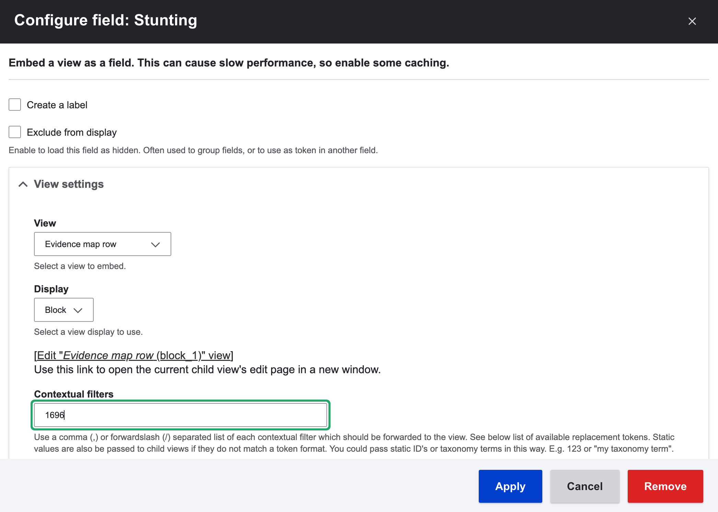
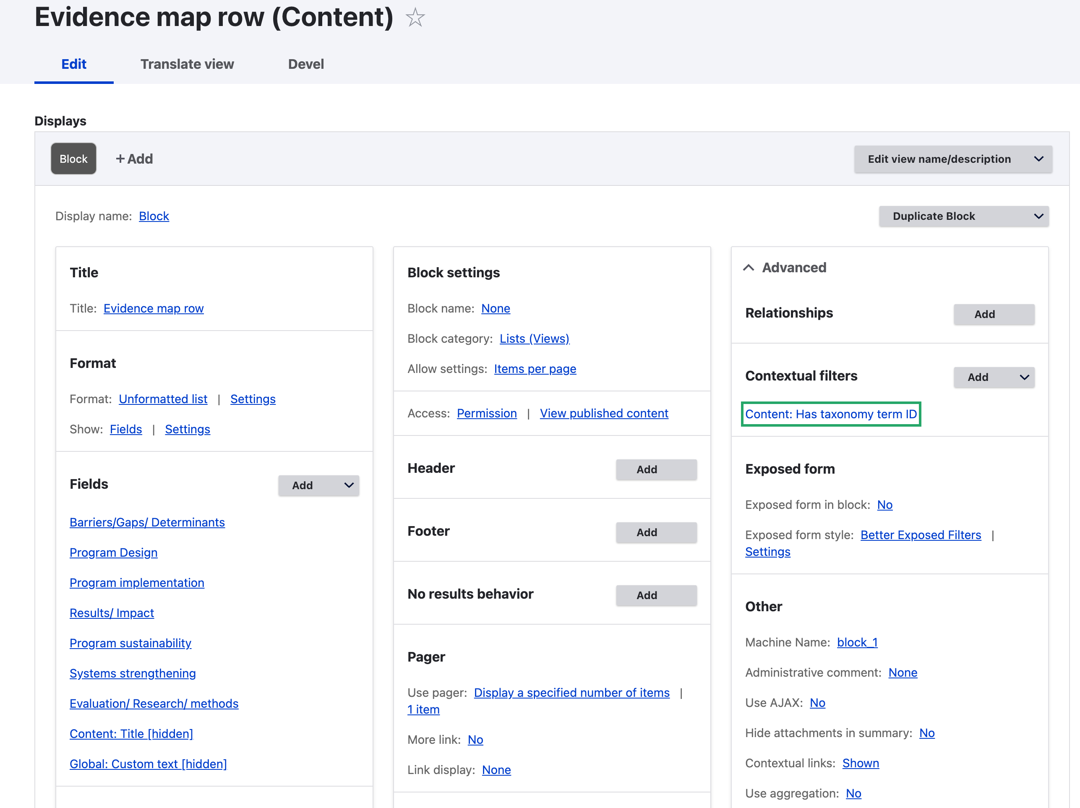
1st Attempt Details: Row View

Slide 14
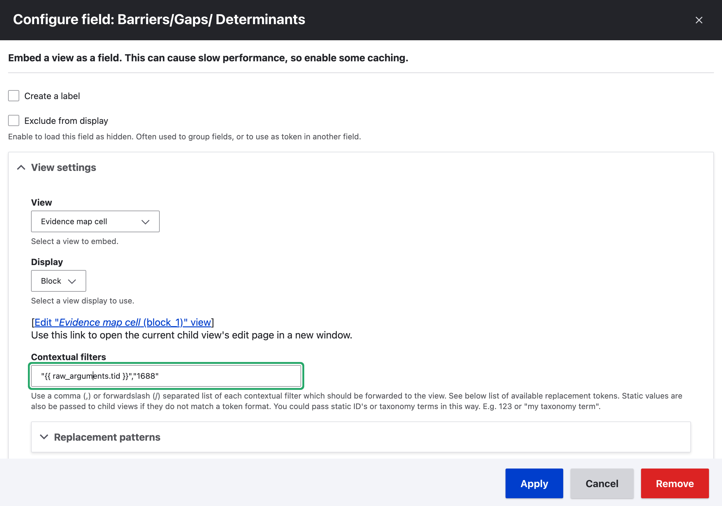
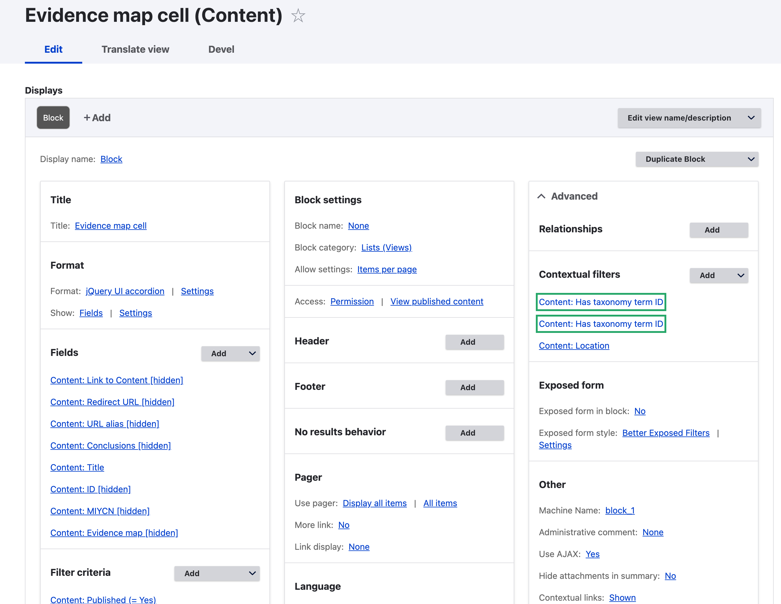
1st Attempt Details: Cell View

Slide 15


Can We Do Better?

Slide 16
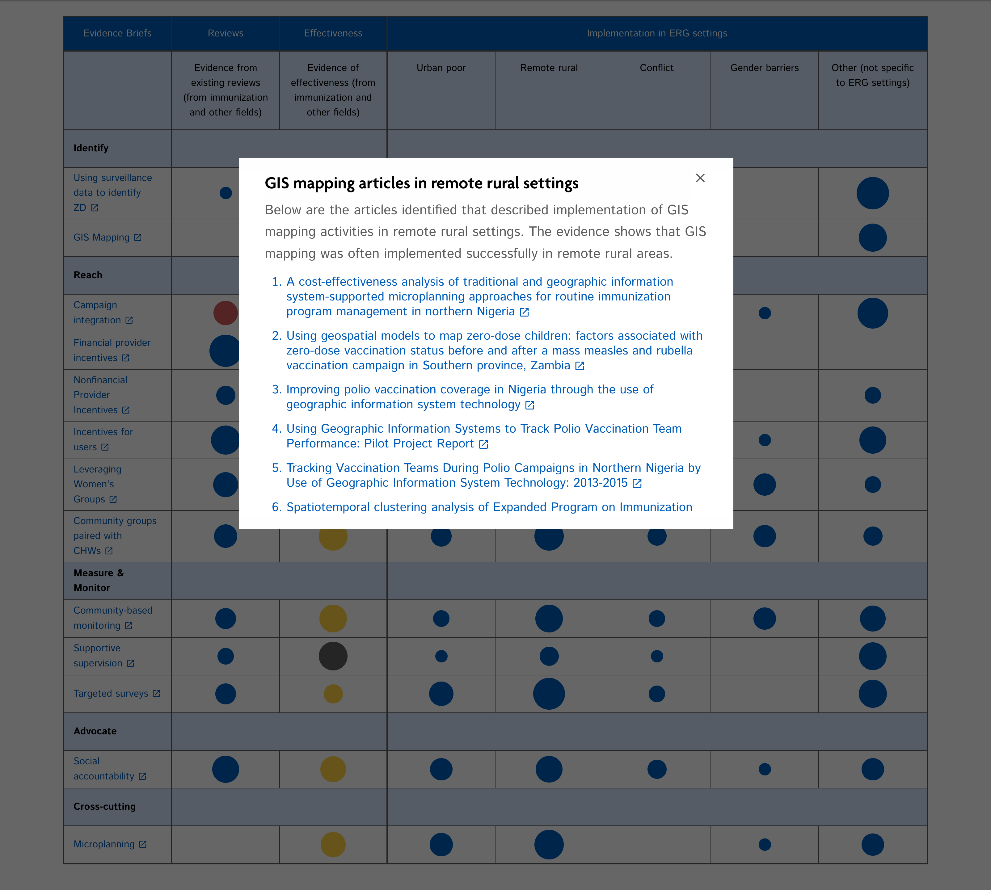
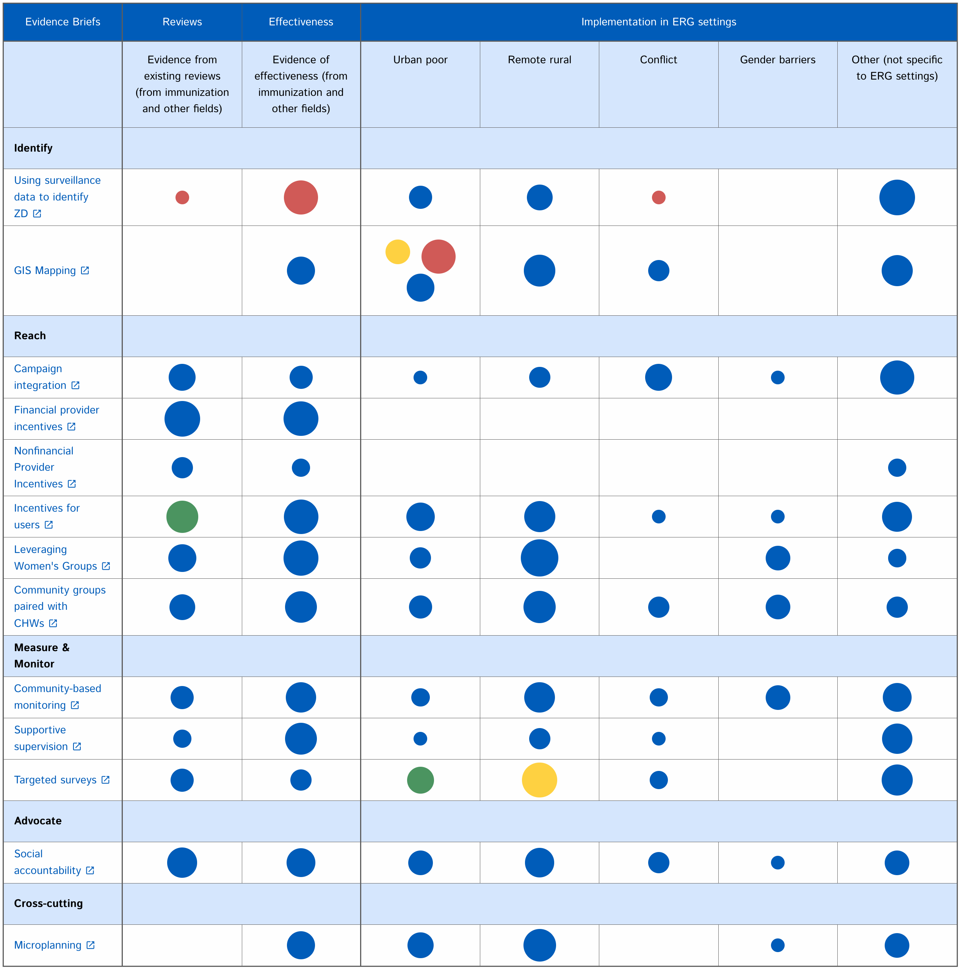
2nd Attempt: What Are We Building This Time?

Slide 17
Views Field View
Views Field View module allows you to embed one view into another view and
pass arguments along.
Rows List View
Row (Cells List)
View 1
Cell View1
…
Cell View M
...
Cell View 1
…
Cell View M
Row (Cells List)
View N
Cell View 1
…
Cell View M

Slide 18
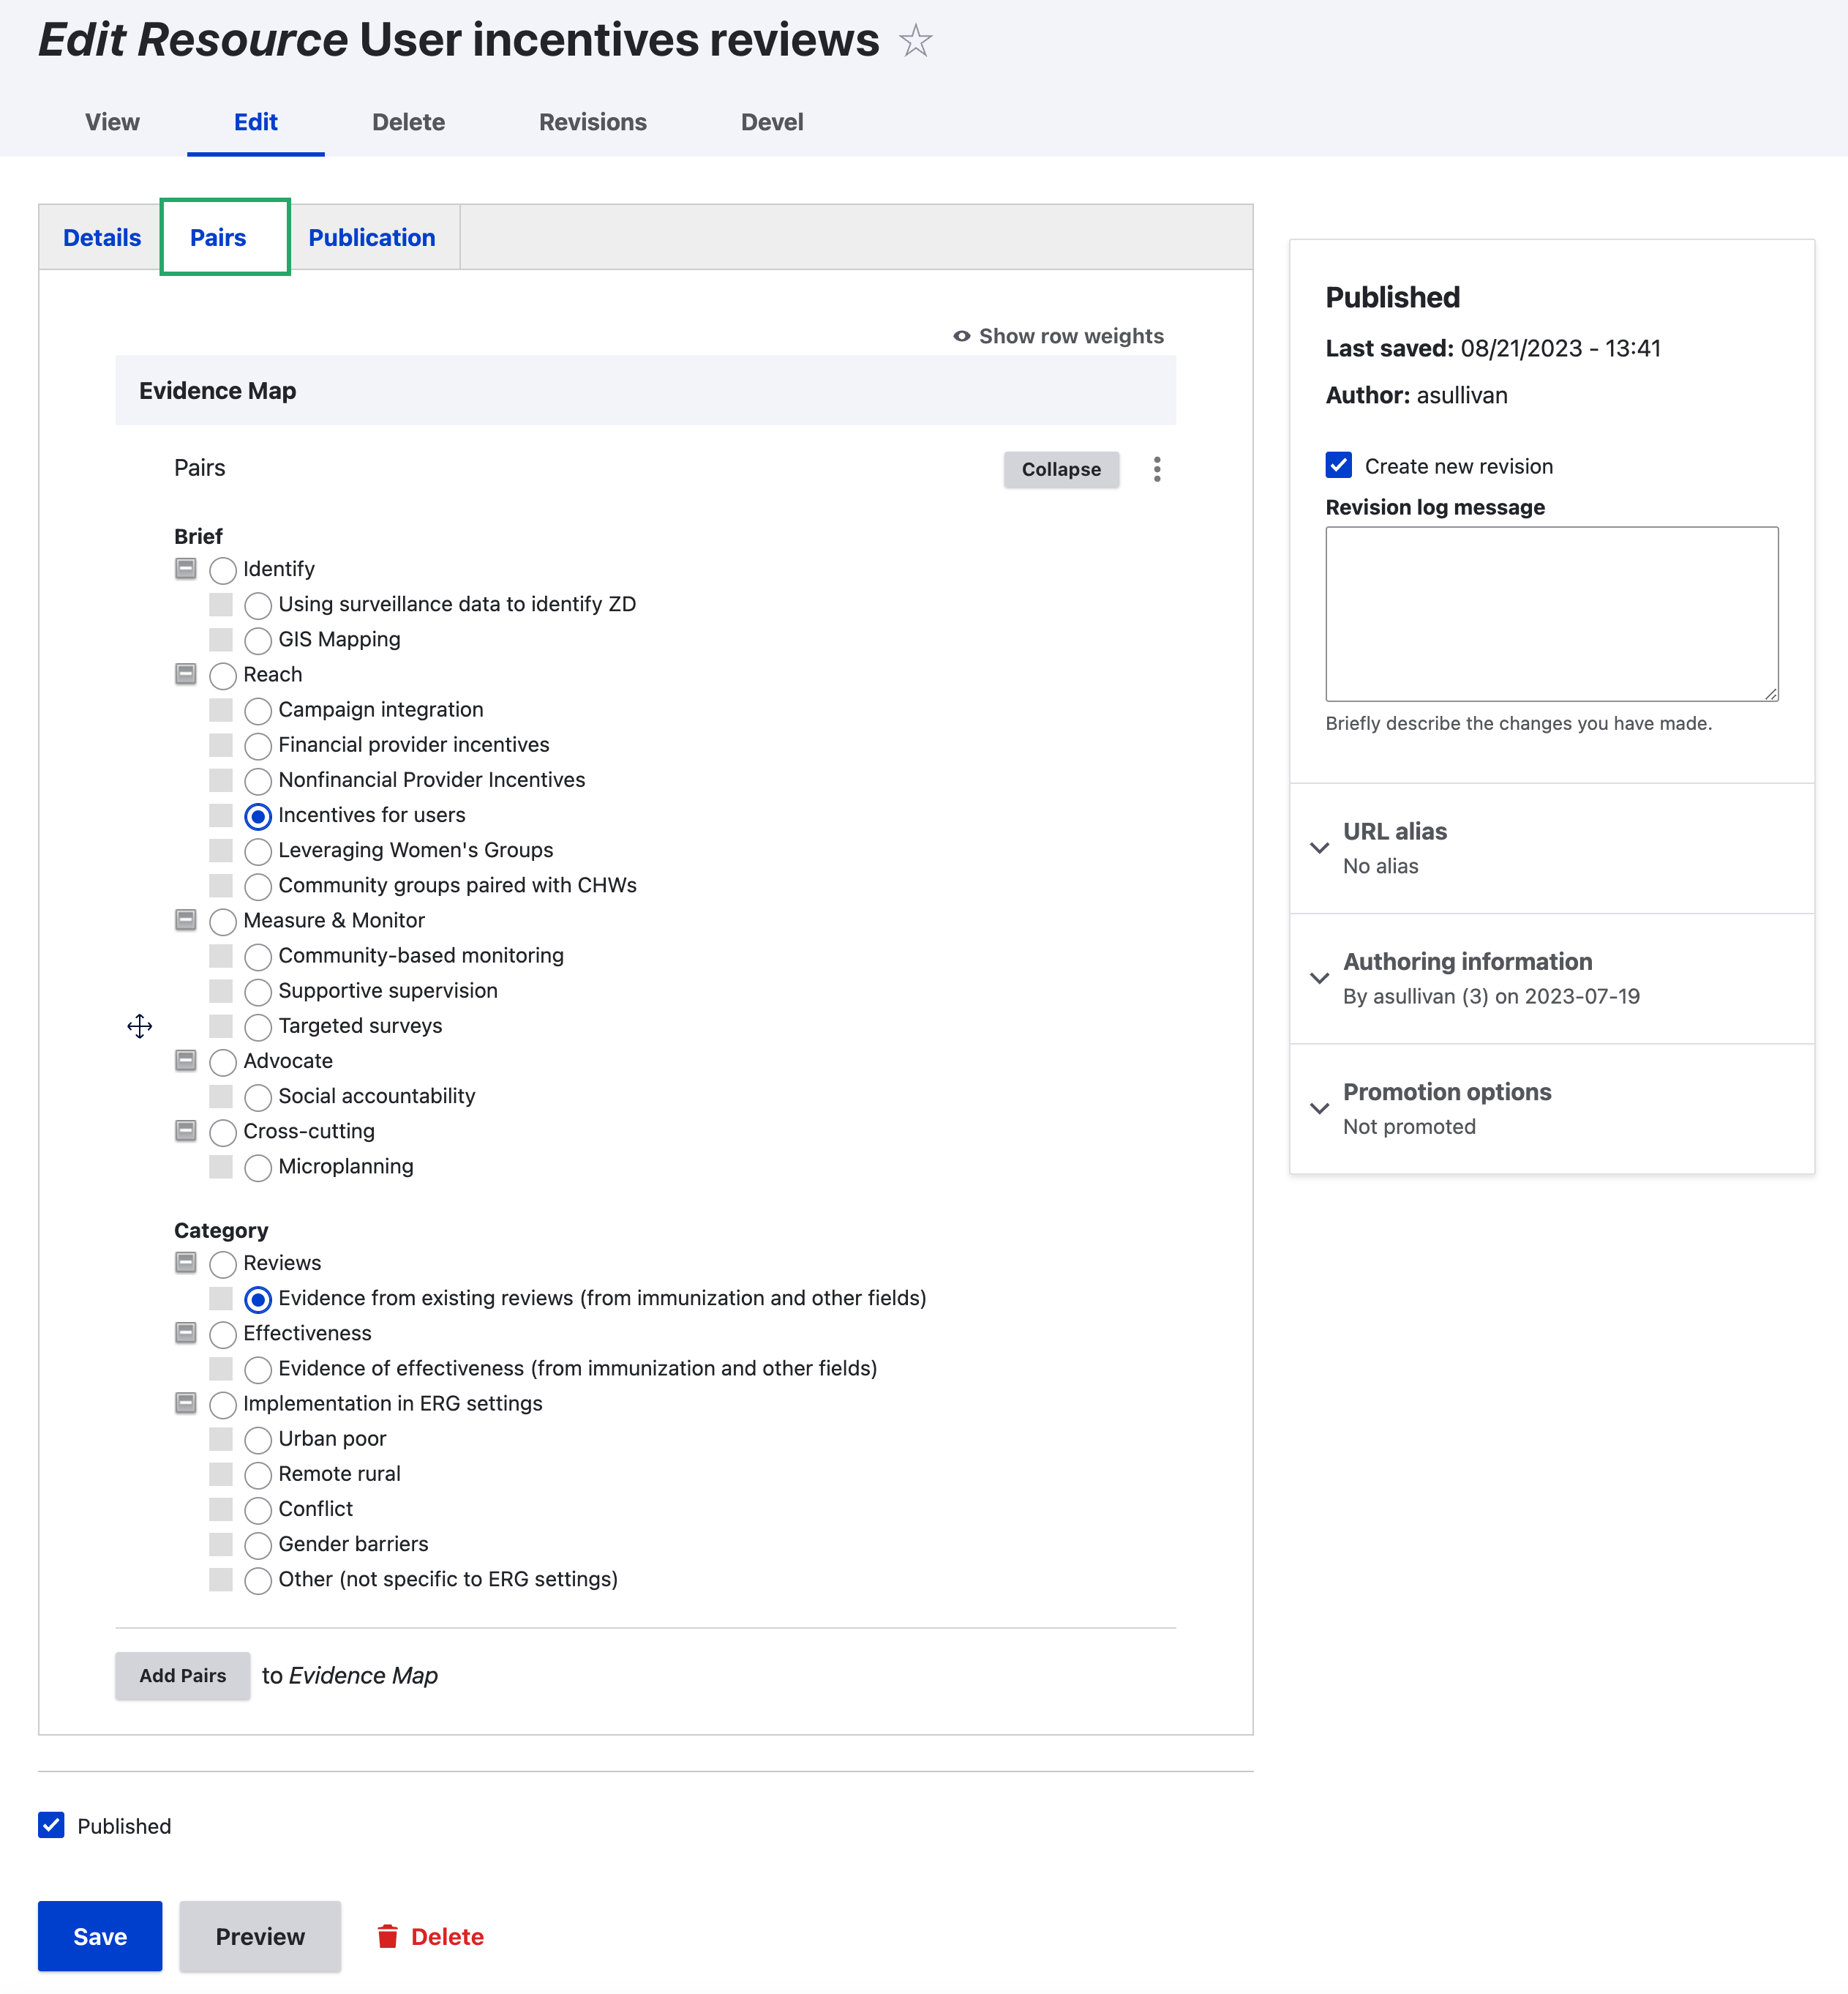

2nd Attempt
Drupal
Views Field View
3 Nested Views (Rows List, Cells List, Single Cell)
Row/Column Group View has one "Views" field only
Dynamic tids from Taxonomy View rows
Paragraphs!
Only wanted combinations of category pairs.
No duplicate/alias nodes

Slide 19
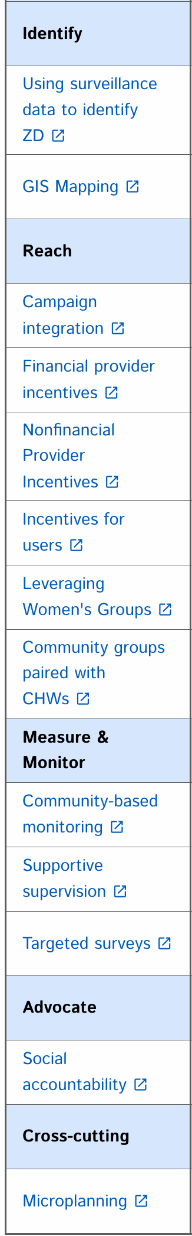
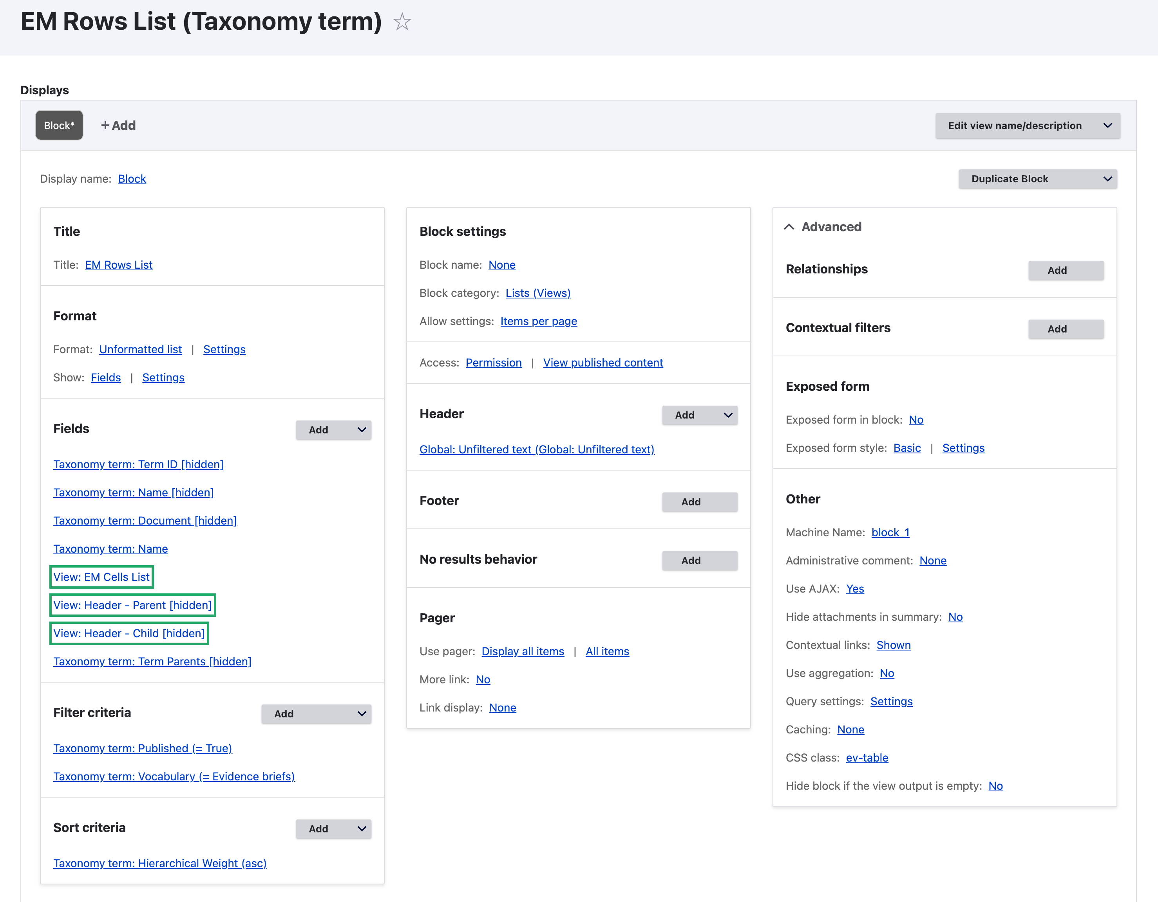
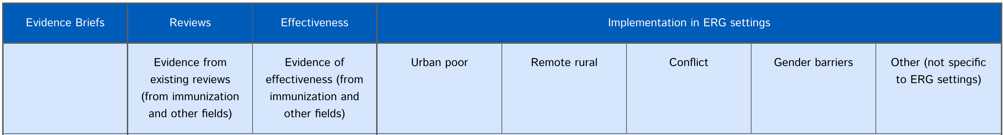
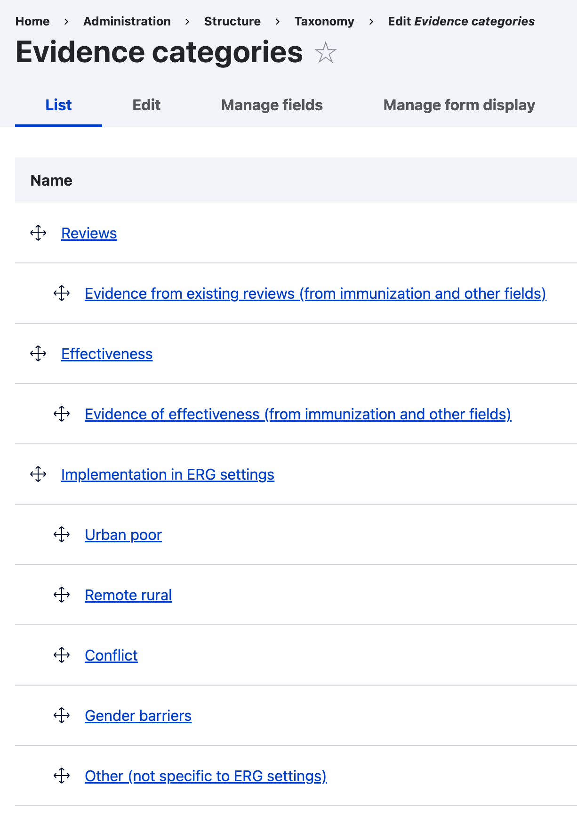
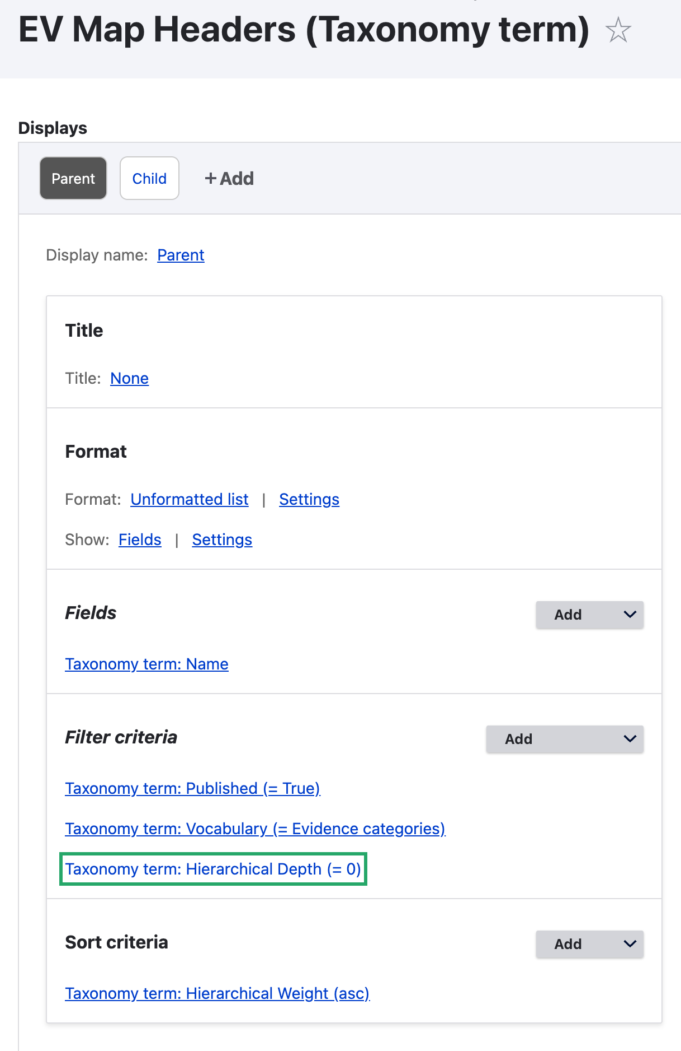
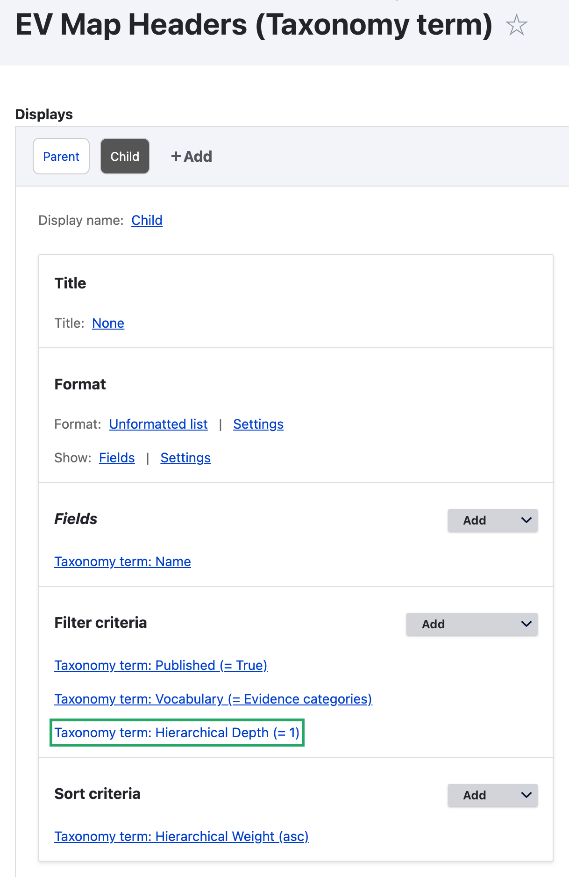
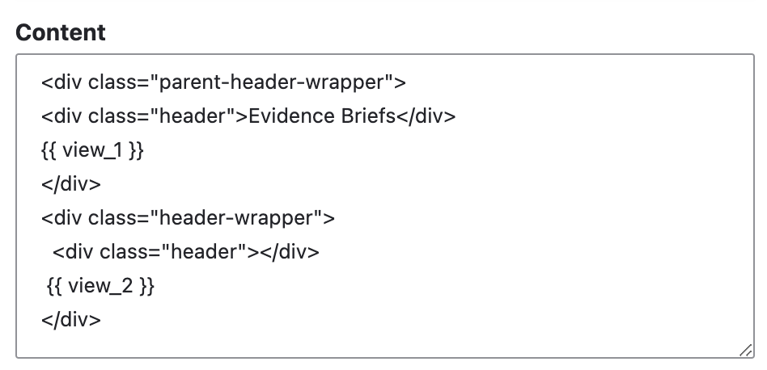
2nd Attempt Details: Rows List View

Slide 20
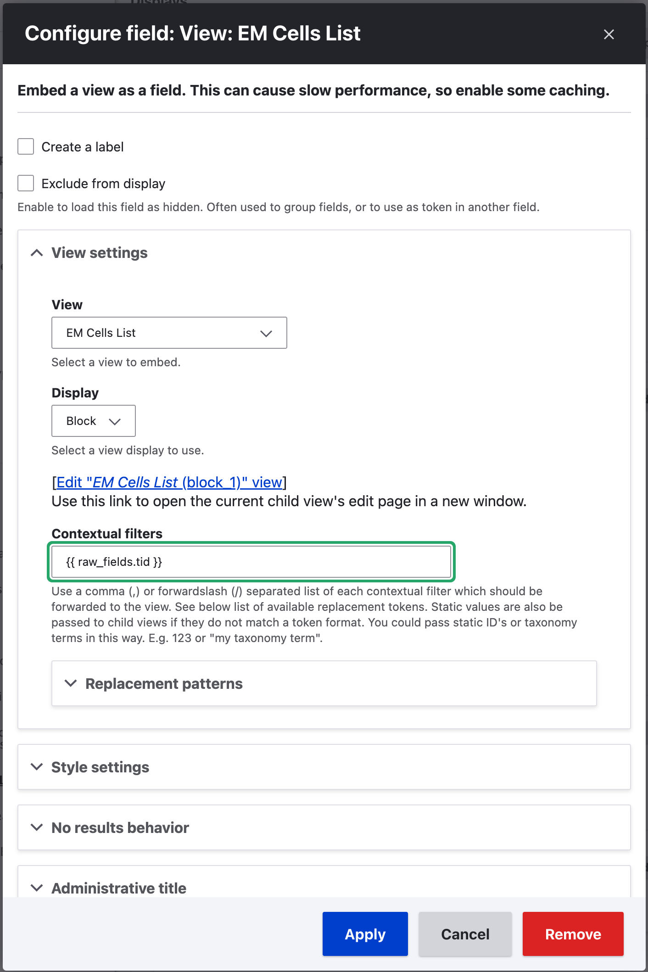
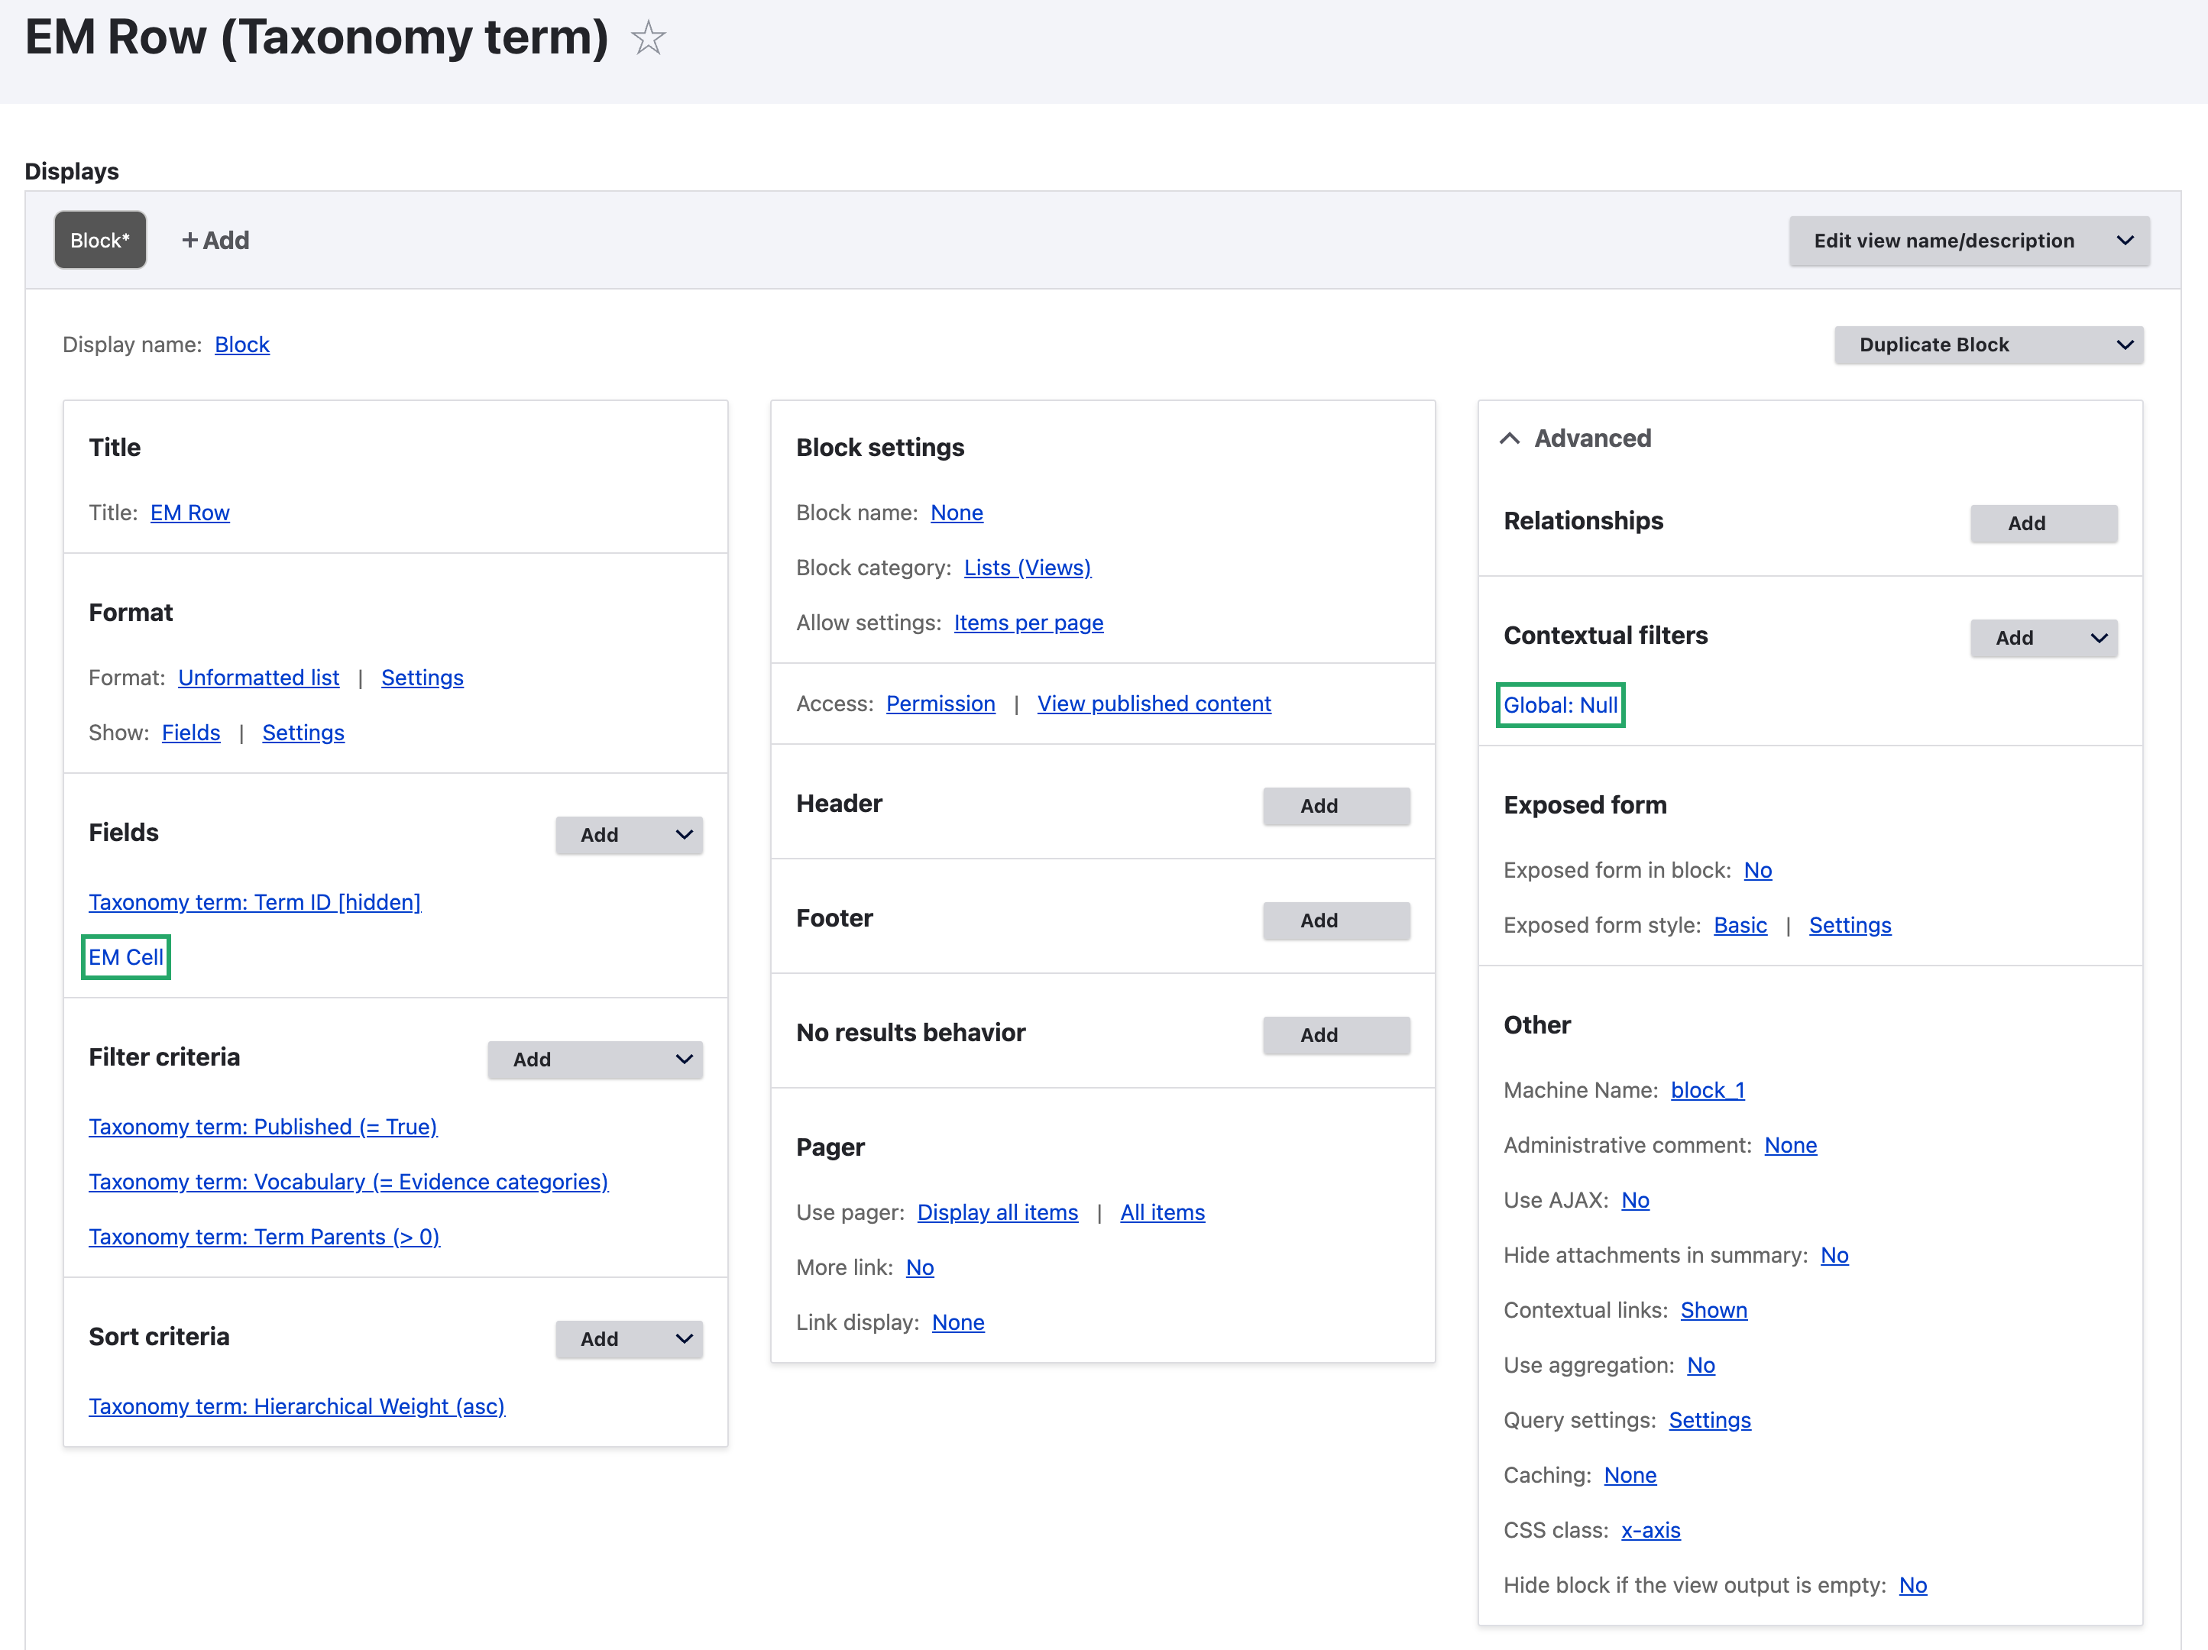
2nd Attempt Details: Row View

Slide 21
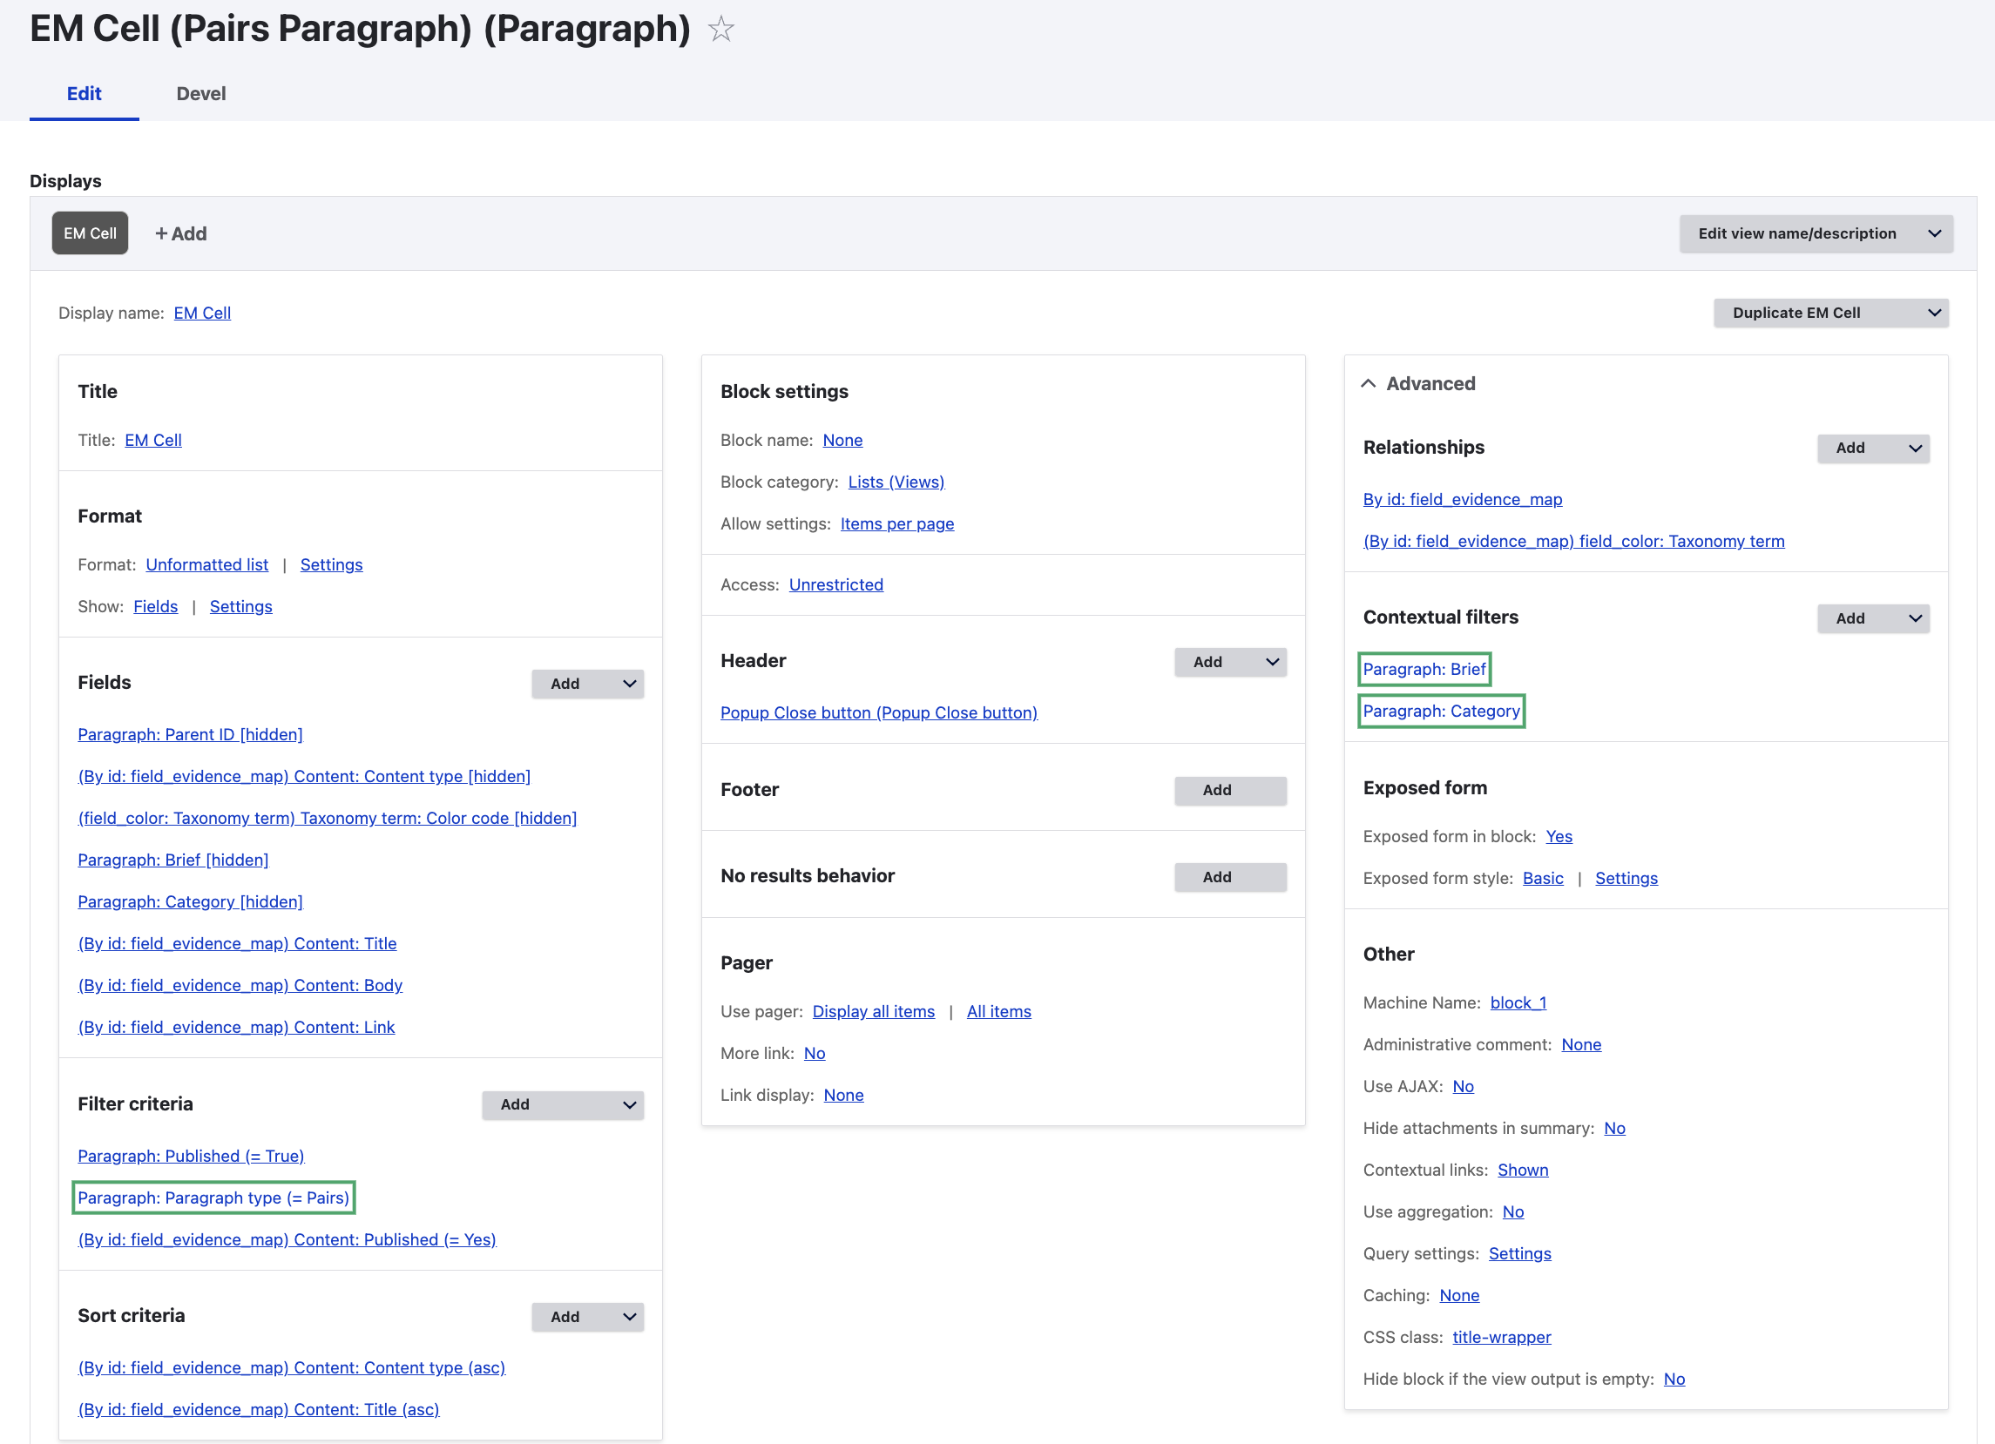
2nd Attempt Details: Cell View

Slide 22
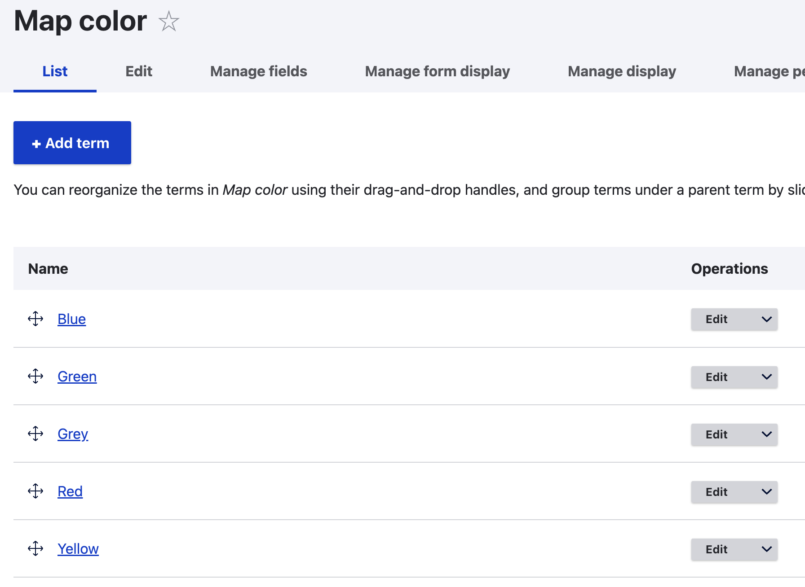
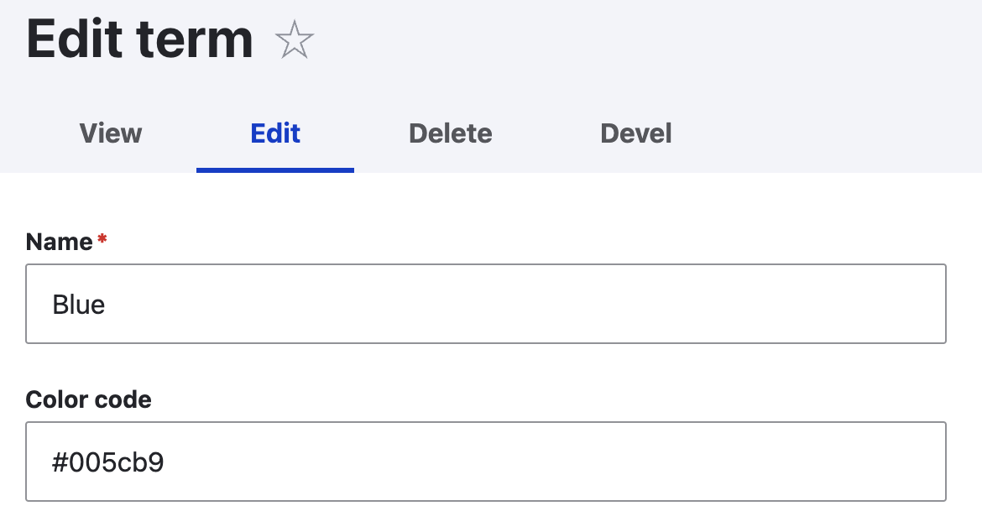
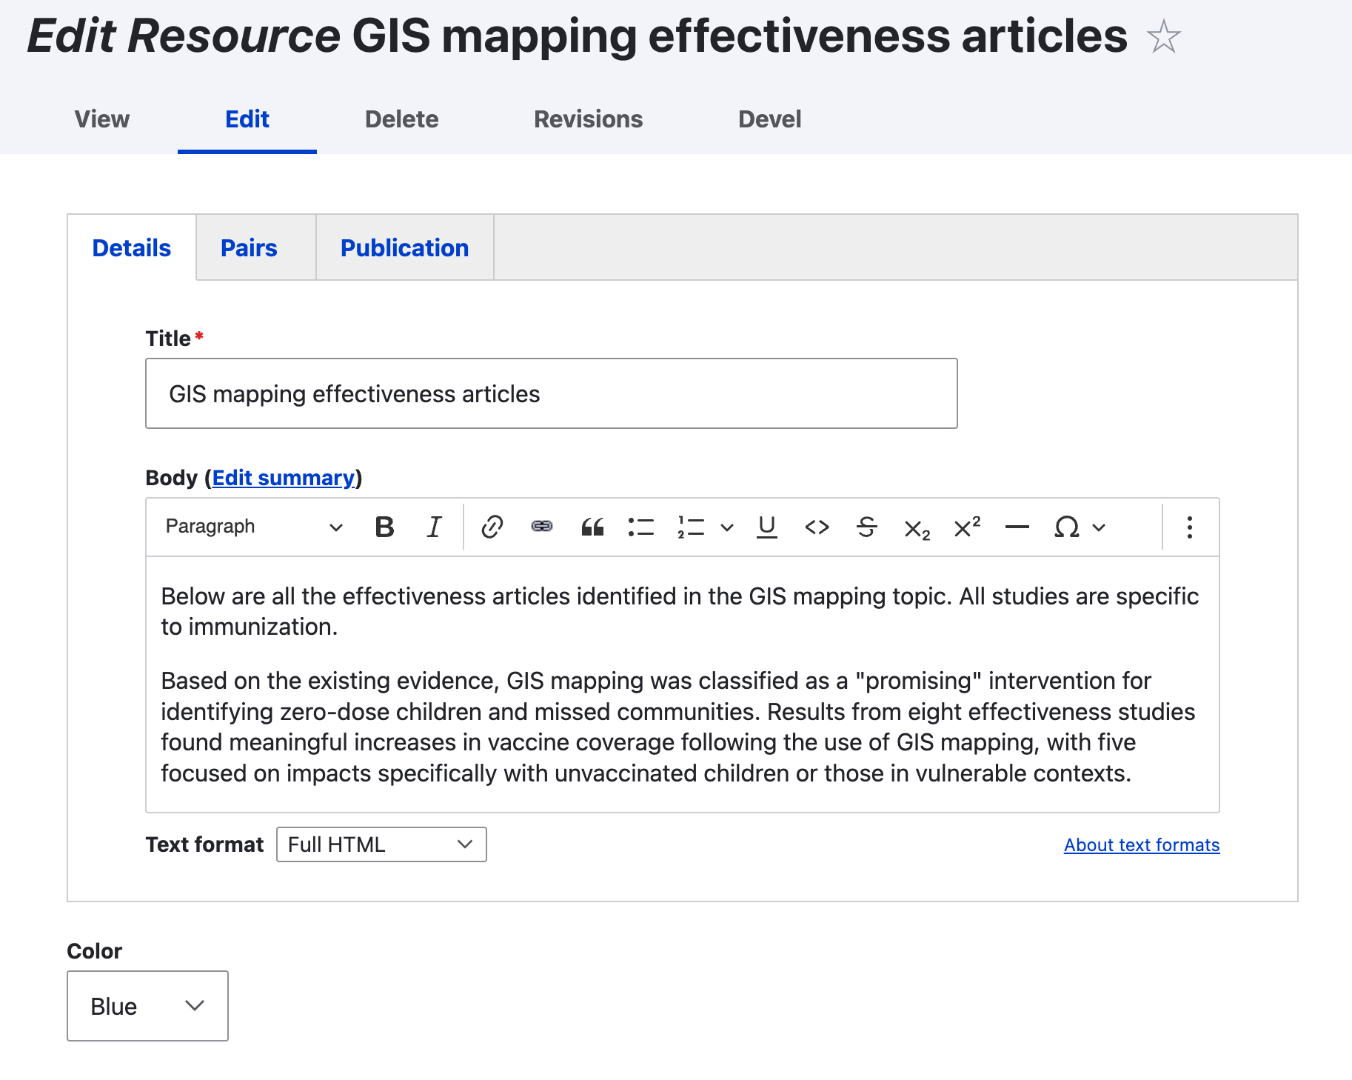
2nd Attempt Details: Adding 3rd Dimension (Colors)

Slide 23
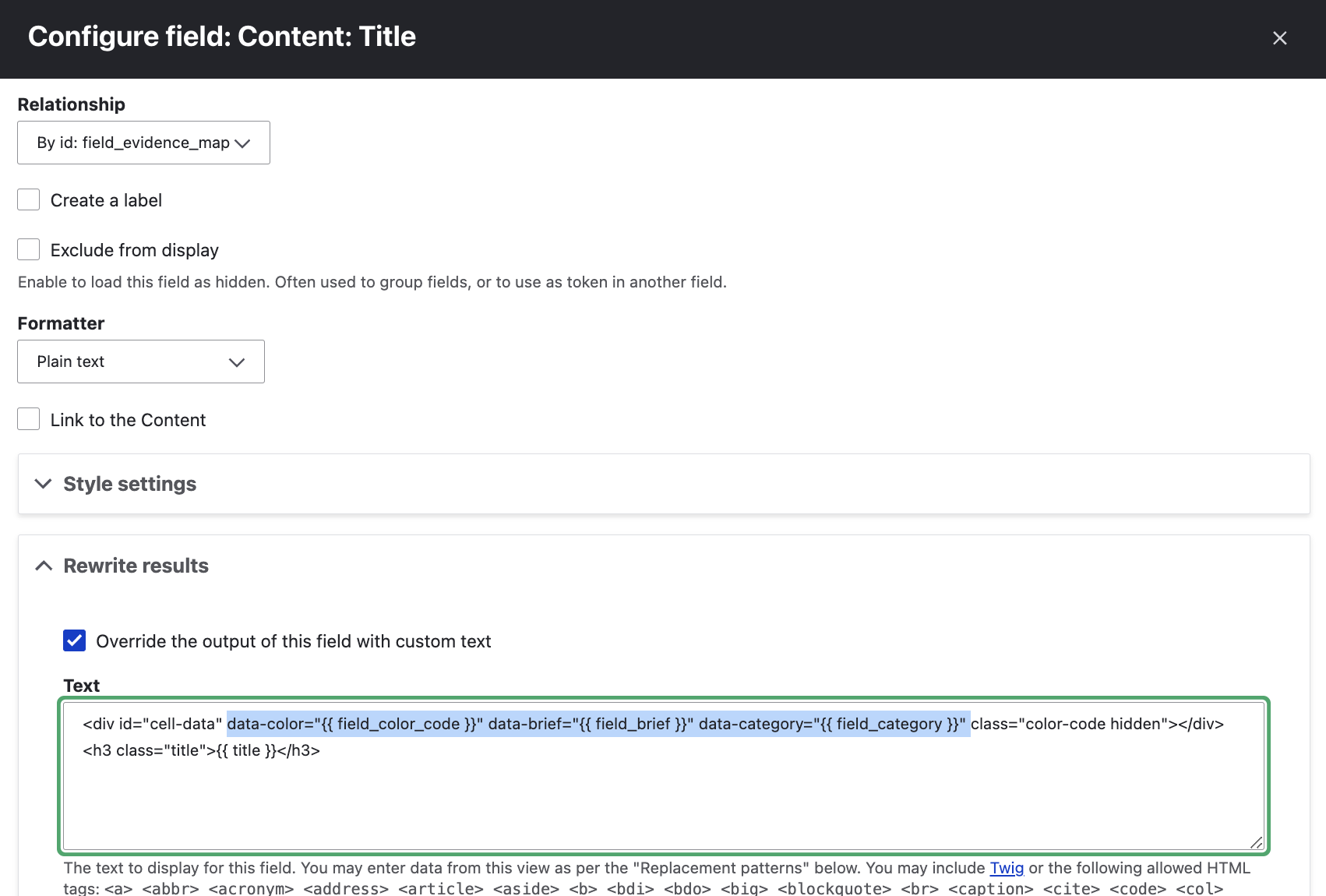
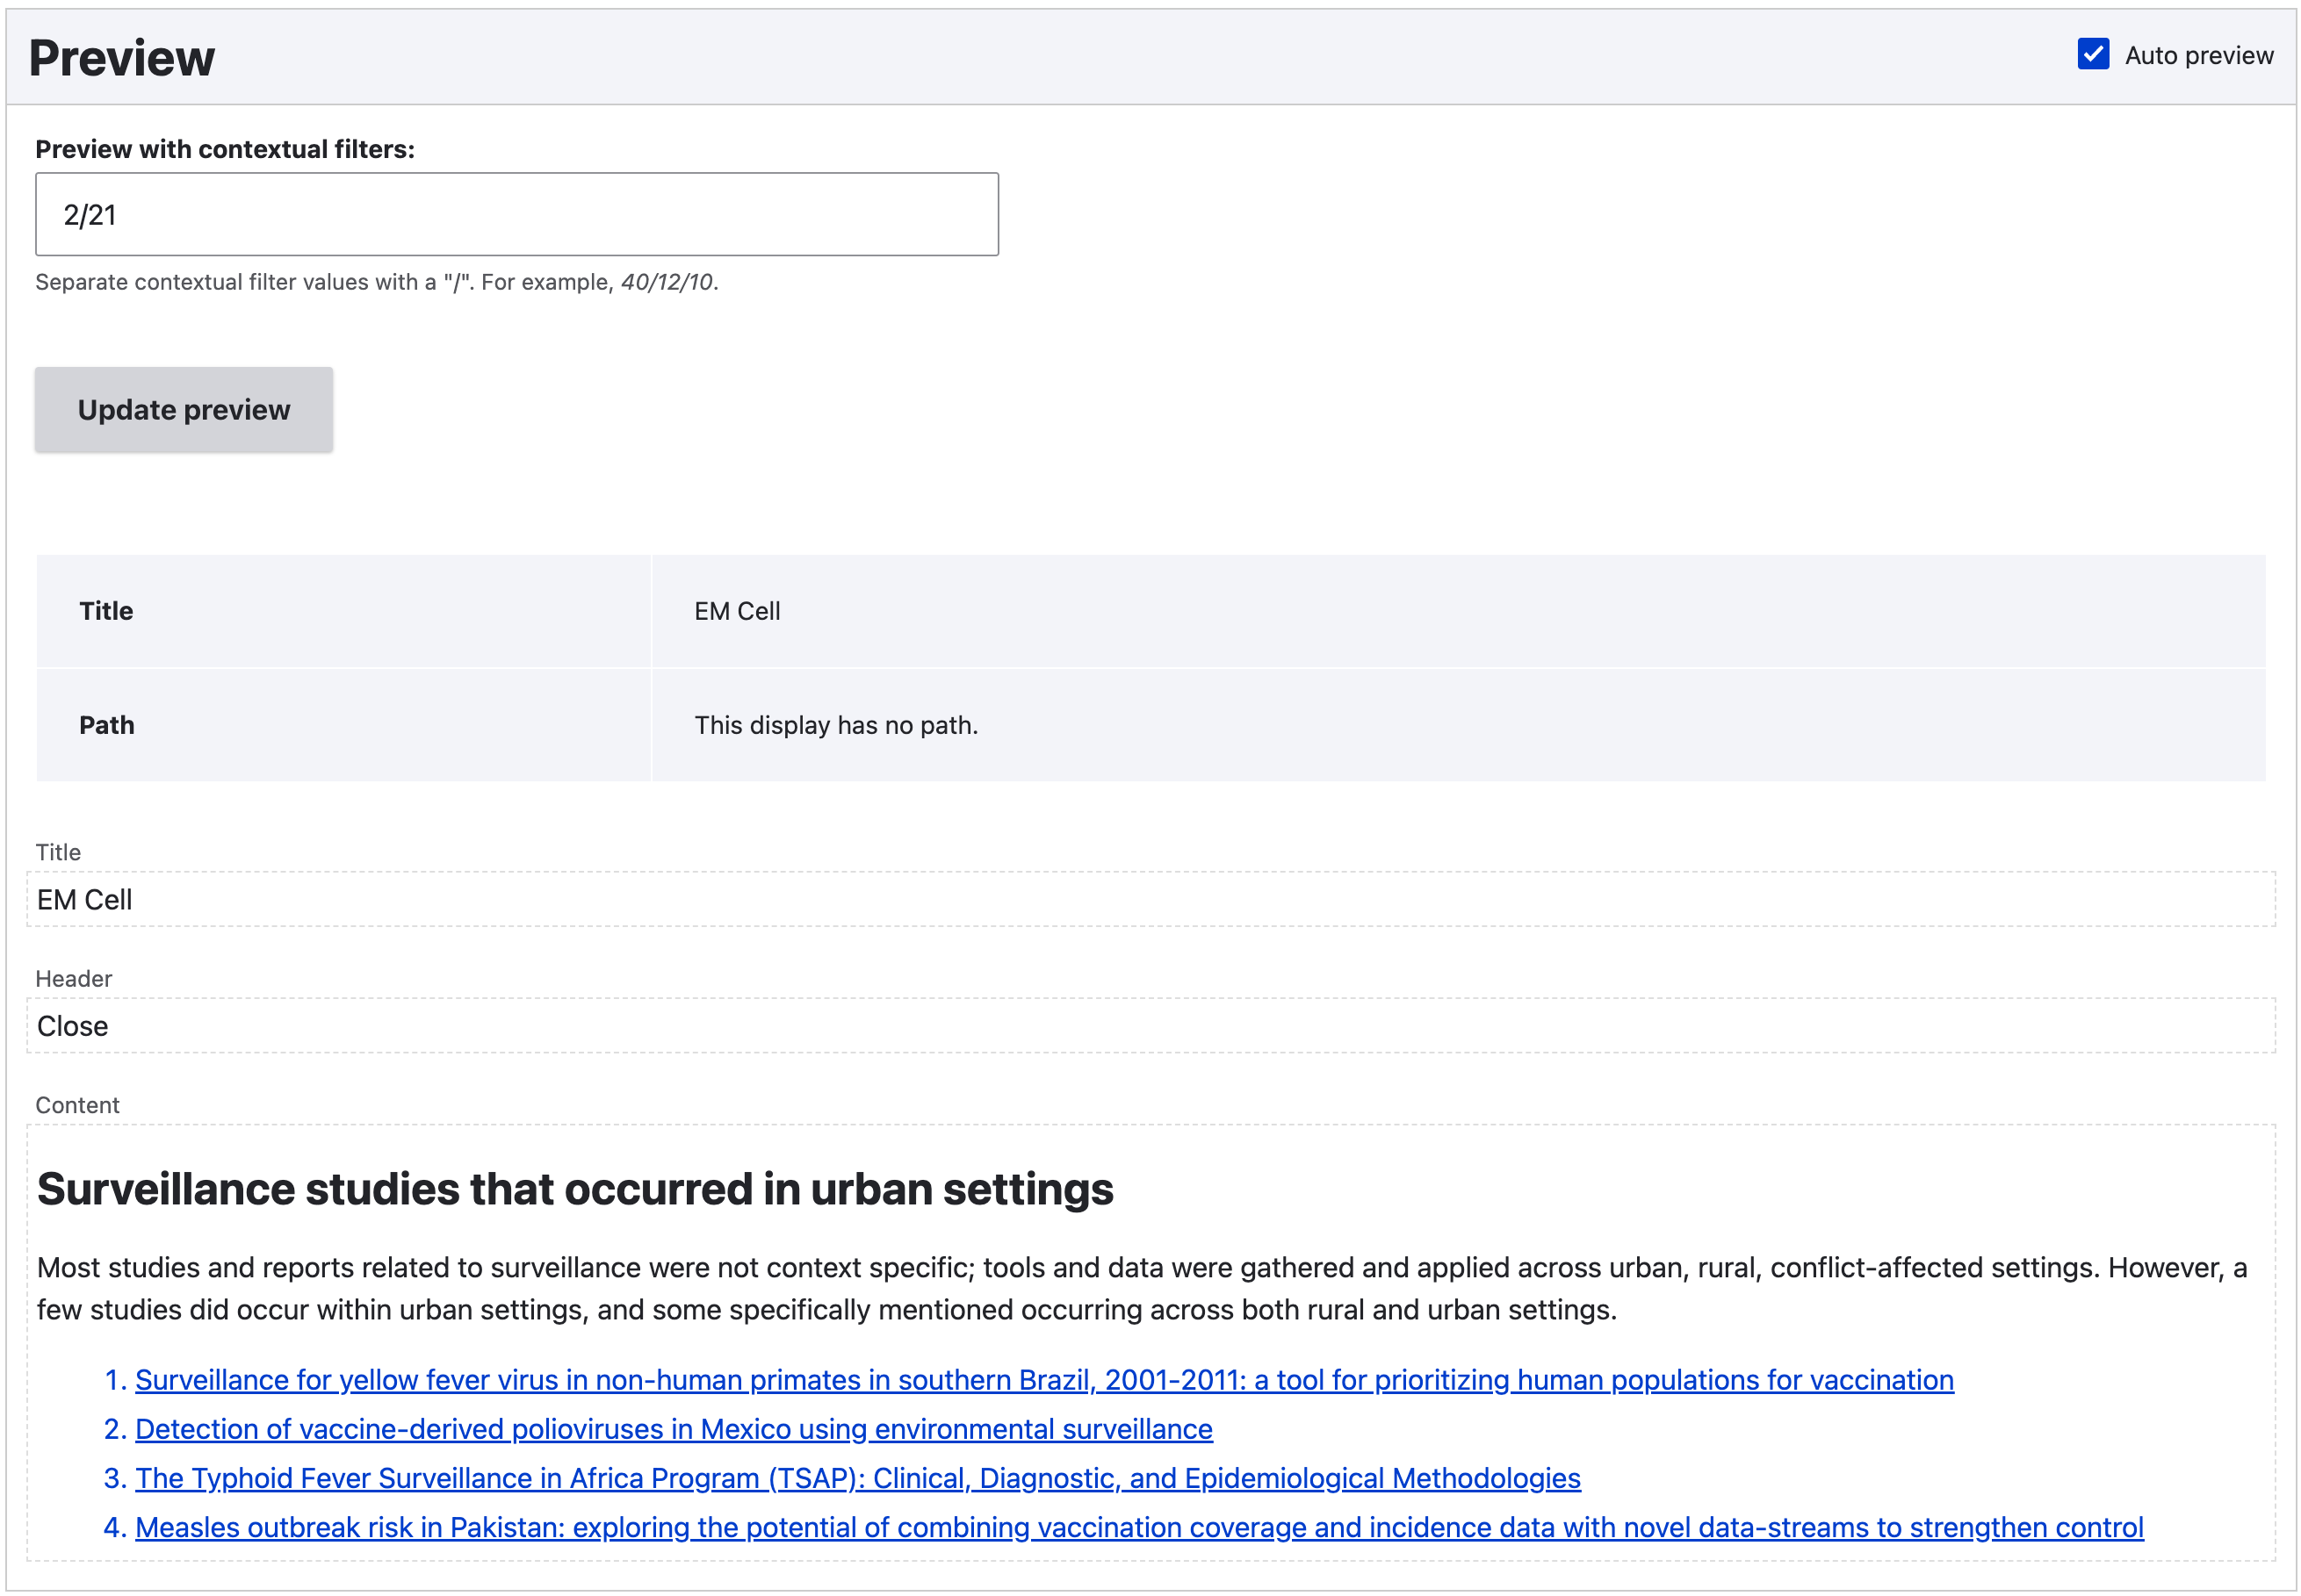
2nd Attempt Details: Cell Header

Slide 24
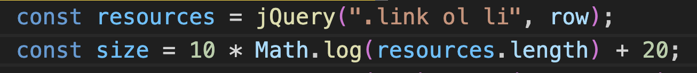
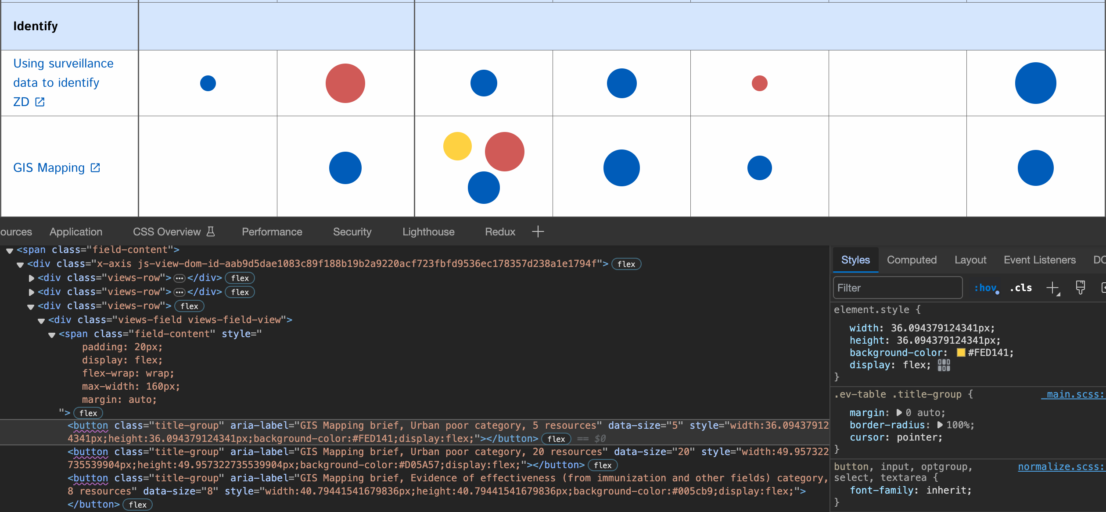
2nd Attempt Details: Adding 4th Dimension (Bubble Size)

Slide 25
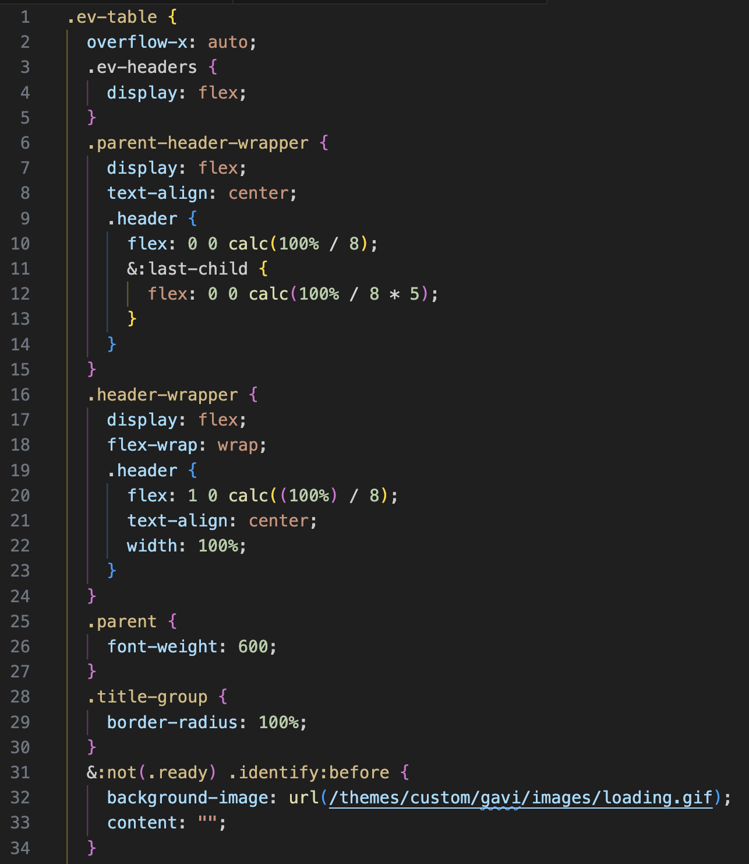
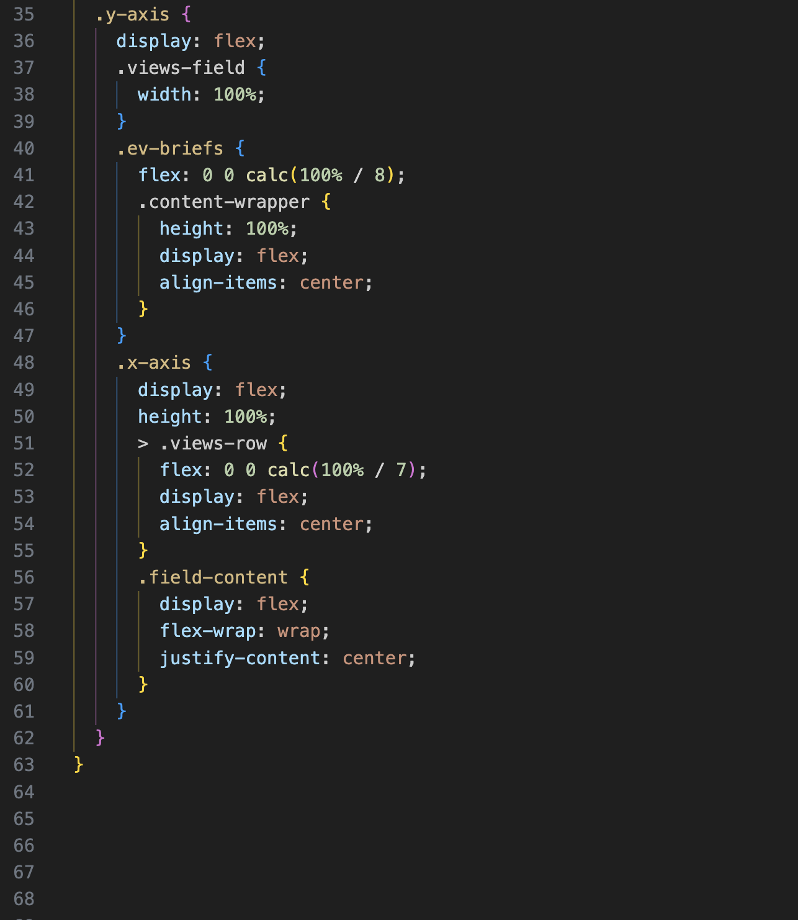
Final Steps (CSS)
Option 1:
Custom theme or module
Option 2:
CSS Injector

Slide 26
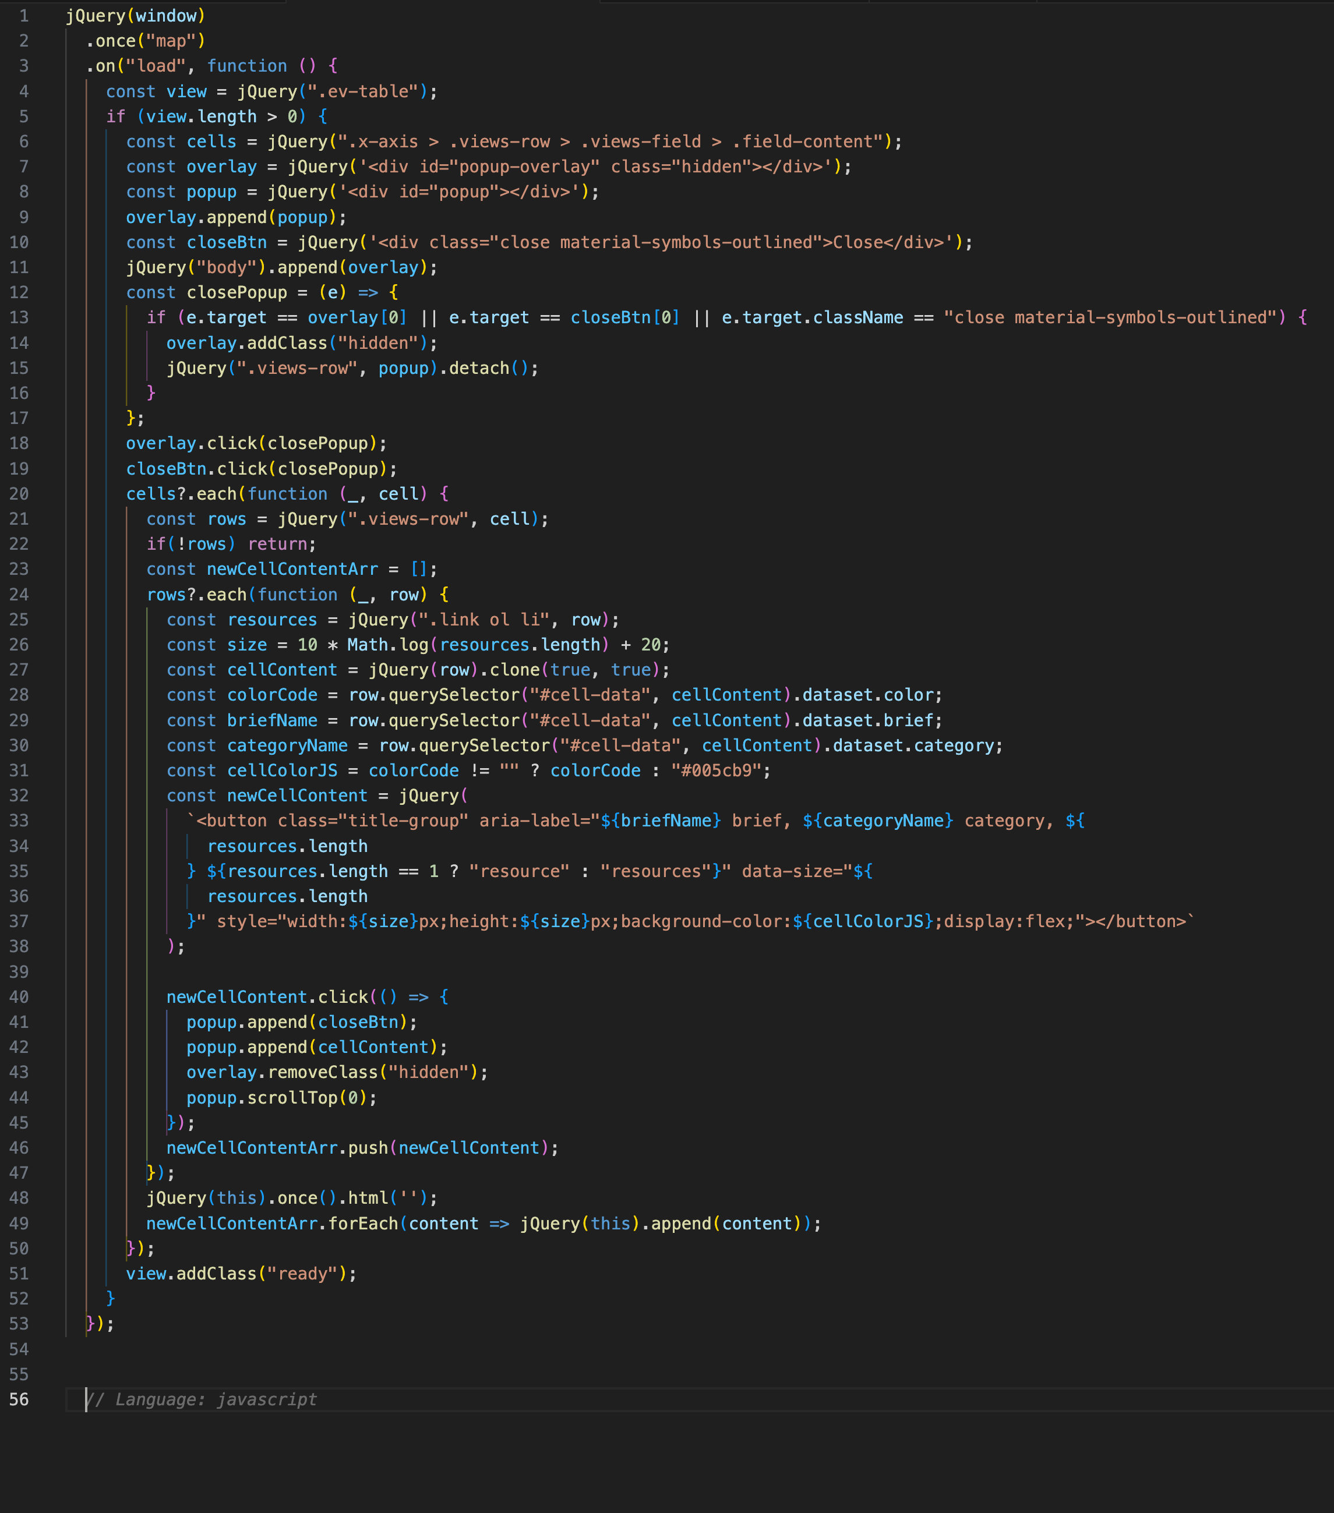
Final Steps (JavaScript)
JS Code
Read the content of every Cell View
Store it in a hidden popup
Set the size and color of a bubble
Replace Cell View content with a colored bubble button that unhides the popup on click
Option 1:
Custom theme or module with a Drupal.behavior()
Option 2:
JS Injector

Slide 27
Conclusions
You can build a multi-dimensional Evidence Map only using Drupal Core and a couple of contrib modules that you may already have installed
No PHP code, custom modules, or themes are required
A minimal amount of JS and CSS will be required though
You can add keep it simple and have only 2 dimensions, or you can go wild and add as many dimensions as you like
Use your Imagination!

Slide 28
Q&A
Questions?

Slide 29
Thank You!
FHI 360
2101 L Street NW, Suite 700
Washington DC, 20037
www.fhi360.org

